Slide 1
Nonlinear Component Analysis as a Kernel Eigenvalue Problem
Jifu Zhao
Huan Yan
Vikram Idiga
Pavan Kumar Nadiminti
Nov. 16, 2016, Urbana

Slide 2
Content
Introduction
Motivation
PCA Recap
Limitations of PCA
Theoretical framework
Kernel PCA
Algorithms
Examples
Summary & Extension

Slide 3
Motivation for Performing PCA
Dimensionality reduction
When we have a very high dimensional data in which some dimensions are not really important we would want to ignore such dimensions
Feature extraction and data visualization
We want to identify important features in a dataset, or maybe we want to visualize the data and want to know what are the best dimensions in which to visualize the data
Identifying major sources of variance
We want to know what is the major sources of variance in our data set

Slide 4
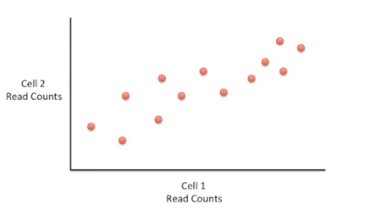
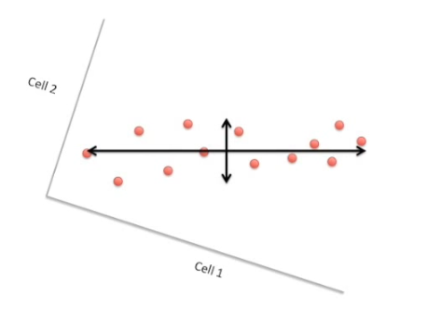
PCA – a recap
Invented by Karl Pearson, 1901*.
Main intuition
Convert possibly correlated variables to linearly uncorrelated variables through orthogonal transformation the dot products of the data points with the principal components give the projections along each of those components
* https://en.wikipedia.org/wiki/Principal_component_analysis https://goo.gl/WbEQAb

Slide 5
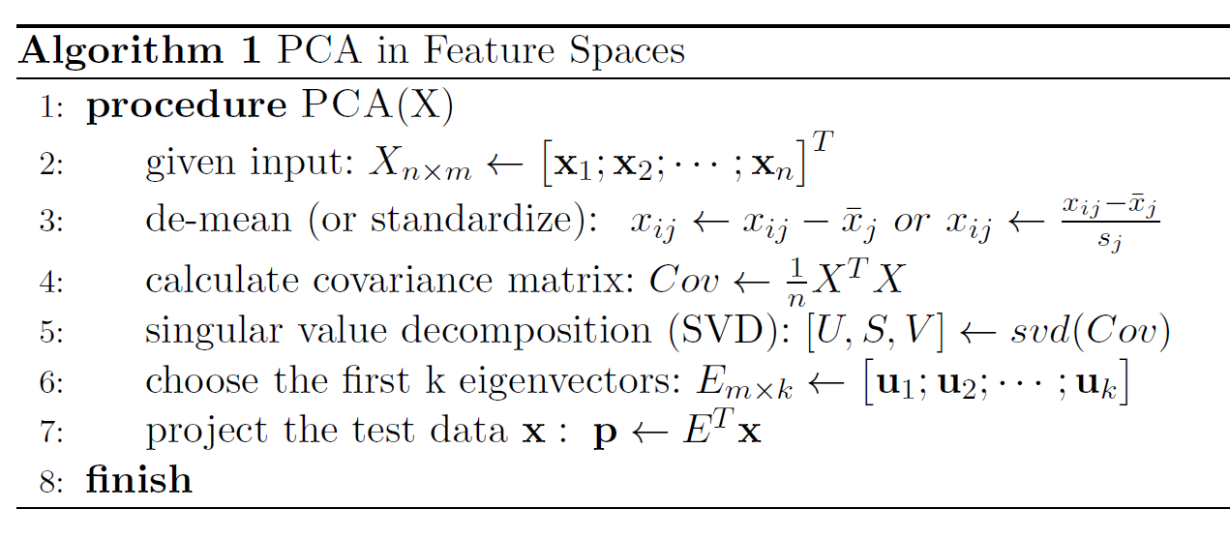
What it means
Obtain a new set of orthogonal axes along which the data is represented better

Slide 6
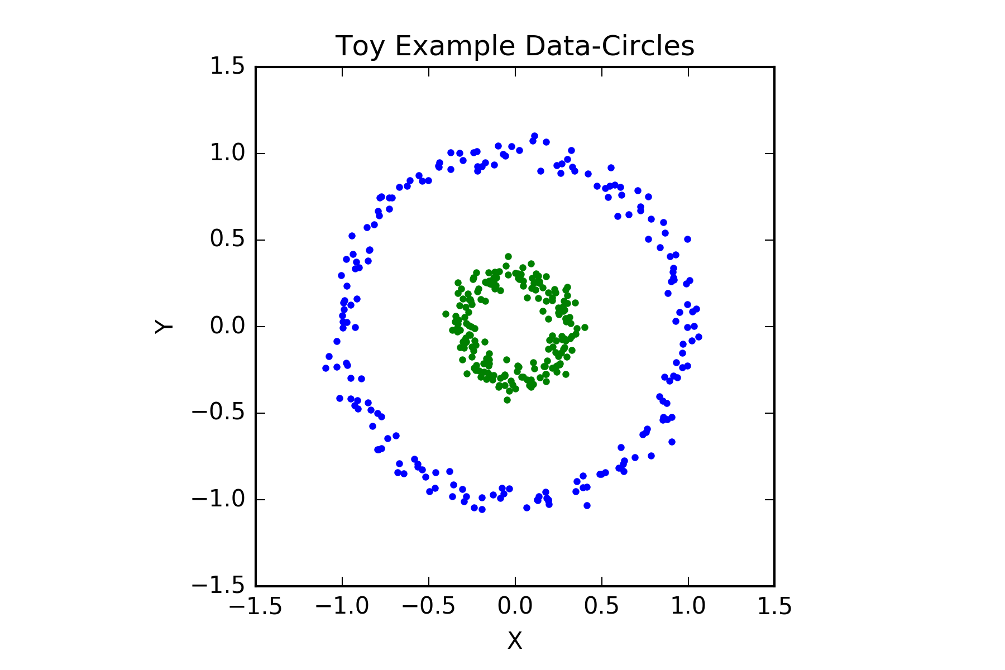
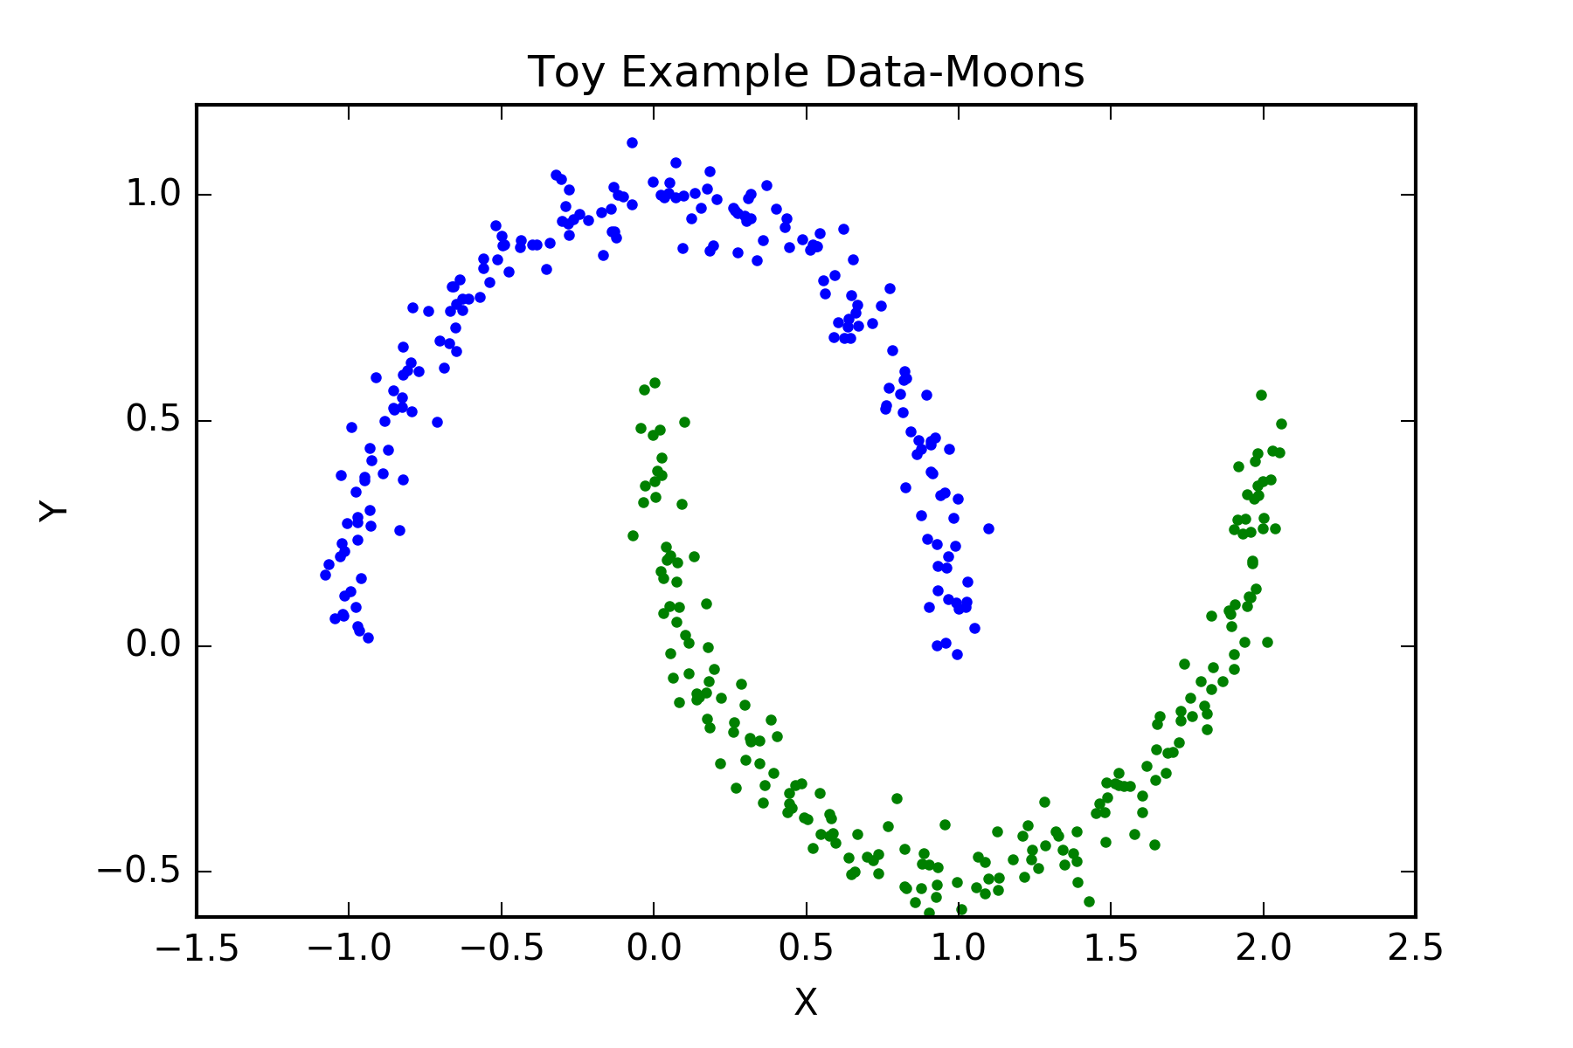
Limitations of linear PCA
If there are m dimensions and n data points , with n> m , then, we would be able to extract at most m features from the data set, even though there may be more features in the data.
PCA cannot easily separate non – linear Data

Slide 7
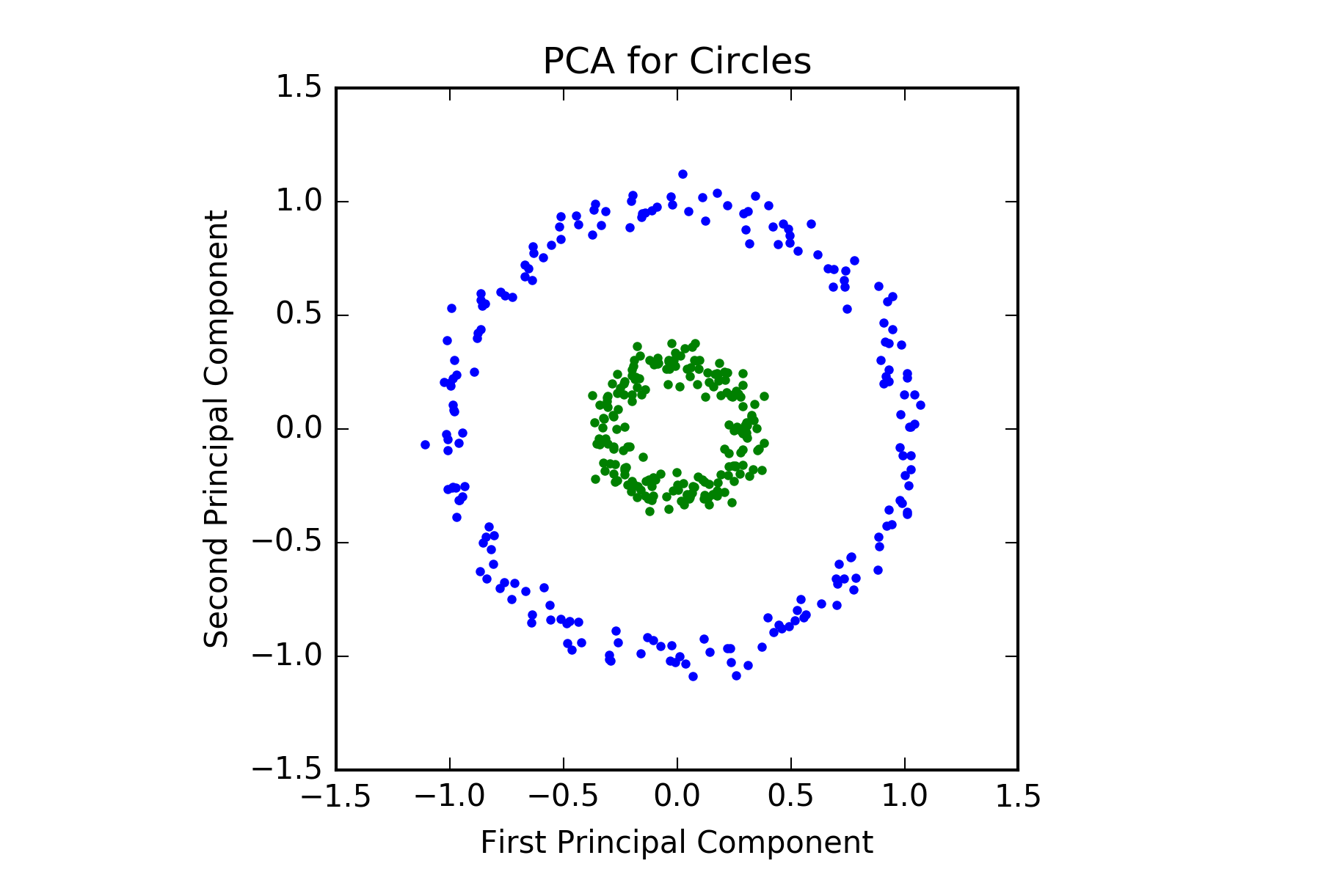
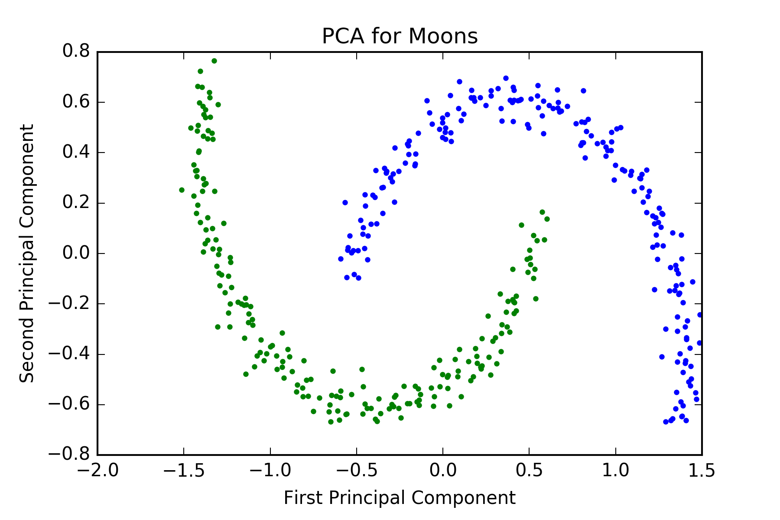
Why Kernel PCA ?

Slide 8
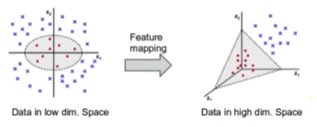
There is no set of axes in the 2-D plane along which we can distinguish the data
We need some non linear transformation to separate the features
Key Idea is to be able to transform /map data into a higher dimensional space where data becomes separable in the new feature space
https://goo.gl/IVW0SM

Slide 9
Why kernel PCA
Non-linear principal components result in better recognition rates for images
Performance can be improved by using more components than is possible in the PCA
Better, as this is essentially an eigen value problem and we are not solving any non –linear optimization problem

Slide 10
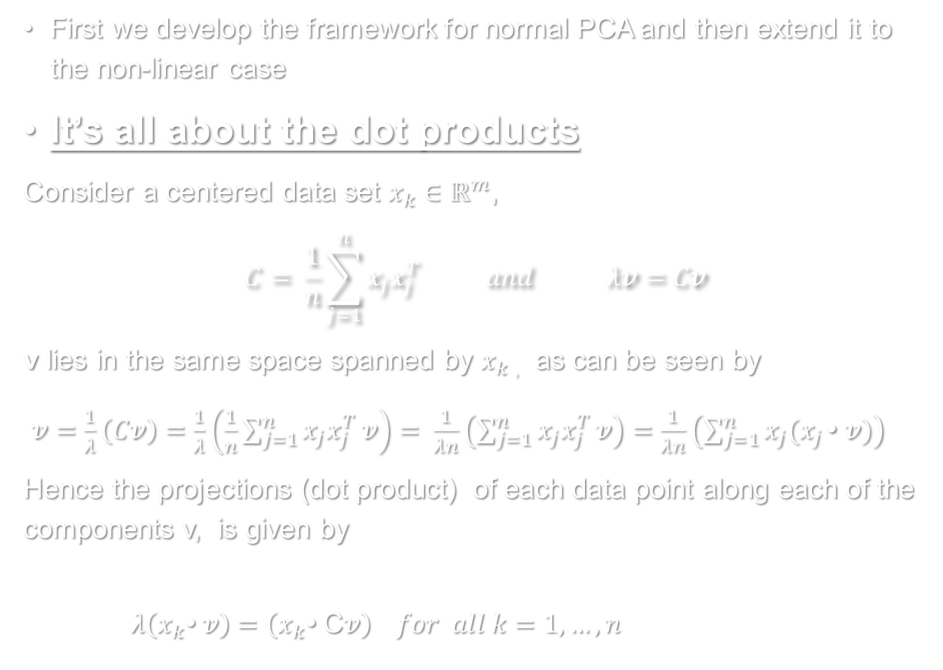
Theoretical framework
First we develop the framework for normal PCA and then extend it to the non-linear case
It’s all about the dot products
Consider a centered data set $x_{k}∈ℝ^{m}$,
$$C= \frac{1}{n}\sum_{j=1}^{n}{x_{j}x_{j}^{T}} and λv=Cv$$
v lies in the same space spanned by $x_{k}$ , as can be seen by
$v=\frac{1}{λ}\left(Cv\right)=\frac{1}{λ}\left(\frac{1}{n}\sum_{j=1}^{n}{x_{j}x_{j}^{T}}v\right)= \frac{1}{λn}\left(\sum_{j=1}^{n}{x_{j}x_{j}^{T}}v\right)=\frac{1}{λn}\left(\sum_{j=1}^{n}{x_{j}(x_{j}}\text{•} v)\right)$
Hence the projections (dot product) of each data point along each of the components v, is given by
$λ\left(x_{k}\text{•} v\right)=\left(x_{k}\text{•} \text{C}v\right) for all k=1,…,n$

Slide 11
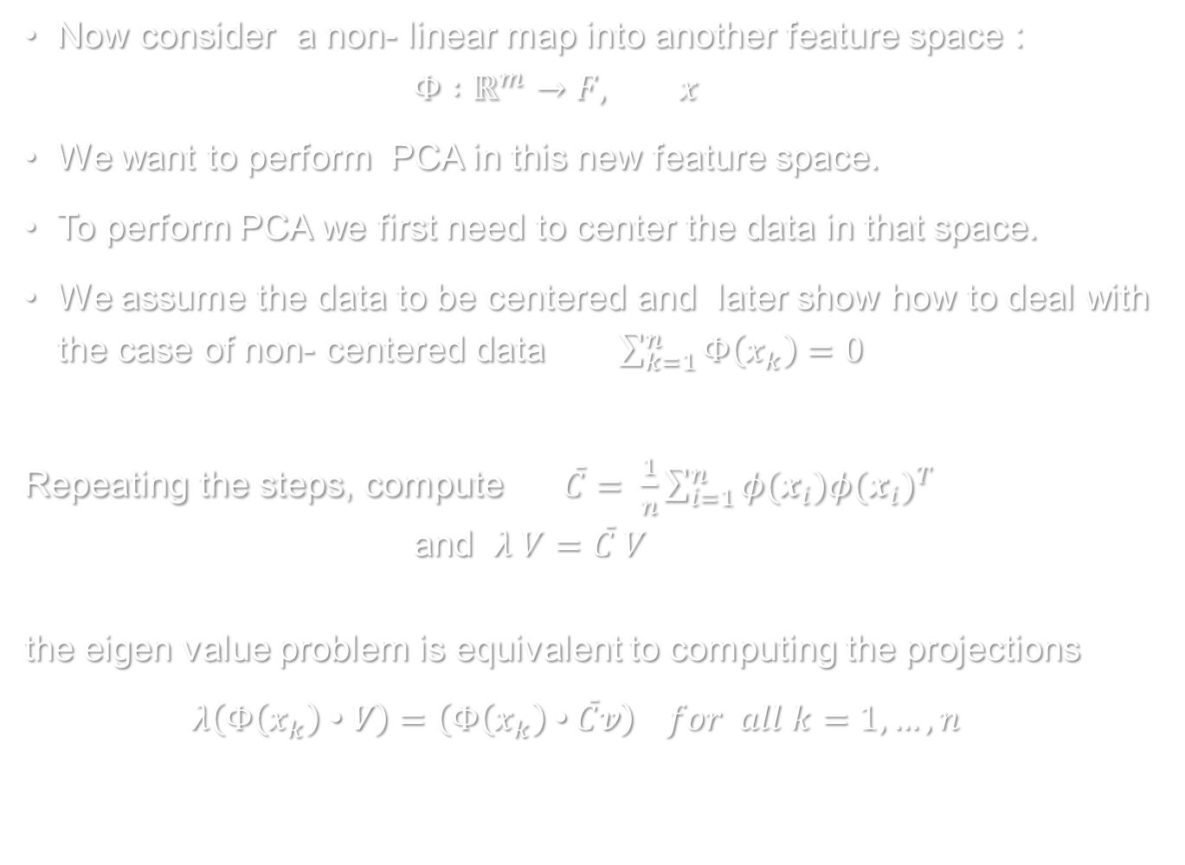
Now consider a non- linear map into another feature space :
$$Φ :ℝ^{m}→F, x \text{↦} \text{X}$$
We want to perform PCA in this new feature space.
To perform PCA we first need to center the data in that space.
We assume the data to be centered and later show how to deal with the case of non- centered data $\sum_{k=1}^{n}{Φ\left(x_{k}\right)=0}$
Repeating the steps, compute $\overline{C}= \frac{1}{n}\sum_{i=1}^{n}{φ(x_{i}){φ(x_{i})}^{T}}$ and $λ V=\overline{C} V$ the eigen value problem is equivalent to computing the projections
$λ\left(Φ\left(x_{k}\right) \text{•} V\right)=\left(Φ\left(x_{k}\right) \text{•} \overline{C}v\right) for all k=1,…,n$

Slide 12
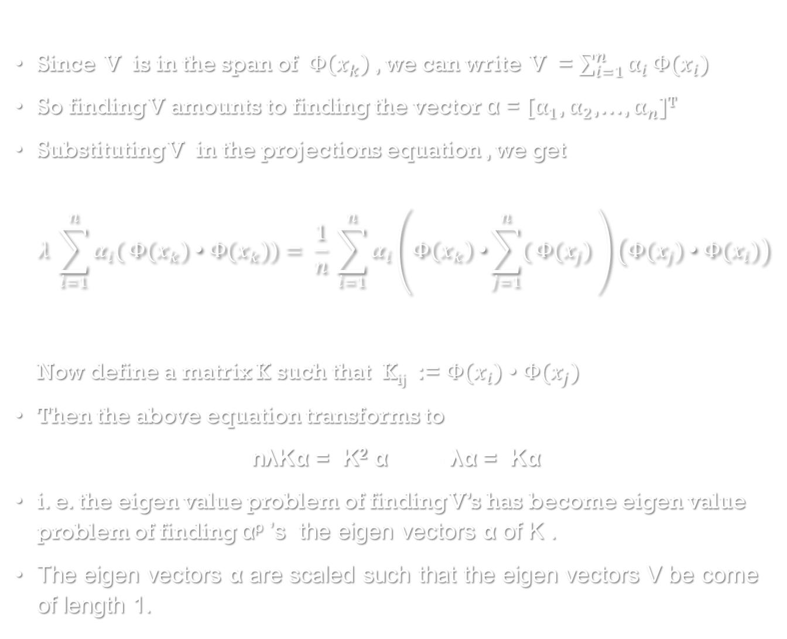
Since V is in the span of $Φ\left(x_{k}\right)$, we can write V = $\sum_{i=1}^{n}{α_{i}}Φ(x_{i})$
So finding V amounts to finding the vector α = [$α_{1}$, $α_{2}$,…, $α_{n}$]^{T}
Substituting V in the projections equation , we get $λ \sum_{i=1}^{n}{α_{i}(}Φ(x_{k}) \text{•} Φ(x_{k}))= \frac{1}{n} \sum_{i=1}^{n}{α_{i}}\left(Φ\left(x_{k}\right) \text{•}\sum_{j=1}^{n}{(}Φ(x_{j}) \right)\left(Φ(x_{j}) \text{• }Φ(x_{i})\right)$ Now define a matrix K such that K_{ij} := $Φ(x_{i})$ • $Φ(x_{j})$
Then the above equation transforms to
nλKα = K² α ⇔ nλα = Kα
i. e. the eigen value problem of finding V’s has become eigen value problem of finding α^{p} ’s the eigen vectors α of K .
The eigen vectors α are scaled such that the eigen vectors V be come of length 1.

Slide 13
Kernel PCA
Proposed by Scholkopf et al., 1998*
Main idea
Expand the original feature space by non-linear transformations
Apply PCA in the transformed feature space
Main drawback
Expanded feature space may have very high dimensions
Applying PCA is computationally expensive or even impossible
Solution -- Kernels
* Friedman, J., Hastie, T., & Tibshirani, R. The elements of statistical learning.

Slide 14
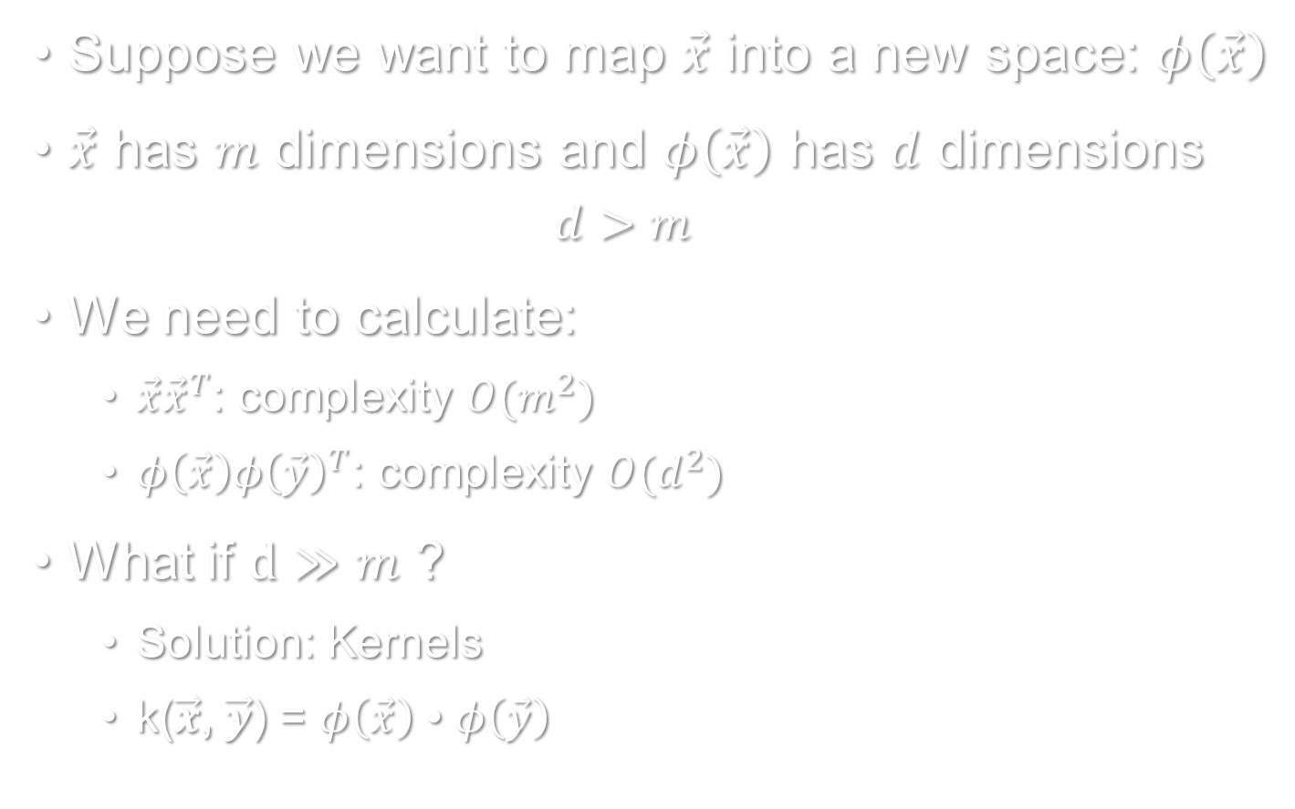
Expand the feature space
Suppose we want to map $\vec{x}$ into a new space: $φ\left(\vec{x}\right)$
$\vec{x}$ has $m$ dimensions and $φ\left(\vec{x}\right)$ has $d$ dimensions
$$d>m$$
We need to calculate:
$\vec{x}{\vec{x}}^{T}$: complexity $O(m^{2})$
$φ\left(\vec{x}\right){φ\left(\vec{y}\right)}^{T}$: complexity $O(d^{2})$
What if $d≫m$ ?
Solution: Kernels
k($\vec{x}$, $\vec{y}$) = $φ\left(\vec{x}\right)$ • $φ\left(\vec{y}\right)$

Slide 15
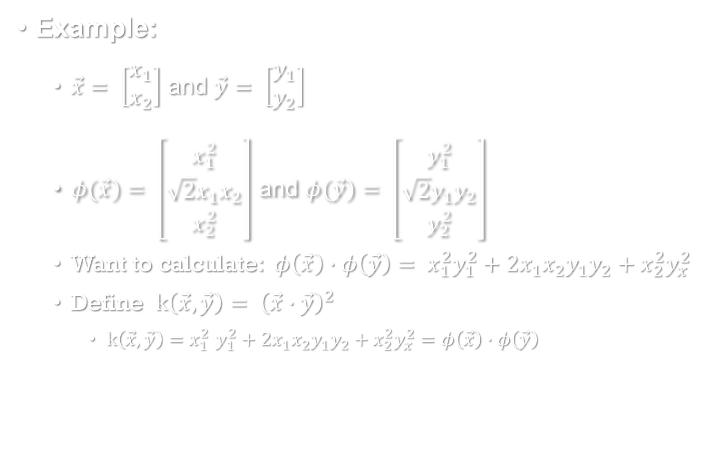
“Kernel Trick”(1)
Example:
$\vec{x}= \left[\begin{matrix}x_{1} \\ x_{2}\end{matrix}\right]$ and $\vec{y}= \left[\begin{matrix}y_{1} \\ y_{2}\end{matrix}\right]$
$φ(\vec{x})= \left[\begin{matrix}x_{1}^{2} \\ \sqrt{2}x_{1}x_{2} \\ x_{2}^{2}\end{matrix}\right]$ and $φ(\vec{y})= \left[\begin{matrix}y_{1}^{2} \\ \sqrt{2}y_{1}y_{2} \\ y_{2}^{2}\end{matrix}\right]$
Want to calculate: $φ\left(\vec{x}\right)∙φ\left(\vec{y}\right)= x_{1}^{2}y_{1}^{2}+2x_{1}x_{2}y_{1}y_{2}+x_{2}^{2}y_{x}^{2}$
Define $k\left(\vec{x}, \vec{y}\right){= \left(\vec{x}∙\vec{y}\right)}^{2}$
$k\left(\vec{x}, \vec{y}\right){=x}_{1}^{2}y_{1}^{2}+2x_{1}x_{2}y_{1}y_{2}+x_{2}^{2}y_{x}^{2}=φ\left(\vec{x}\right)∙φ\left(\vec{y}\right)$

Slide 16
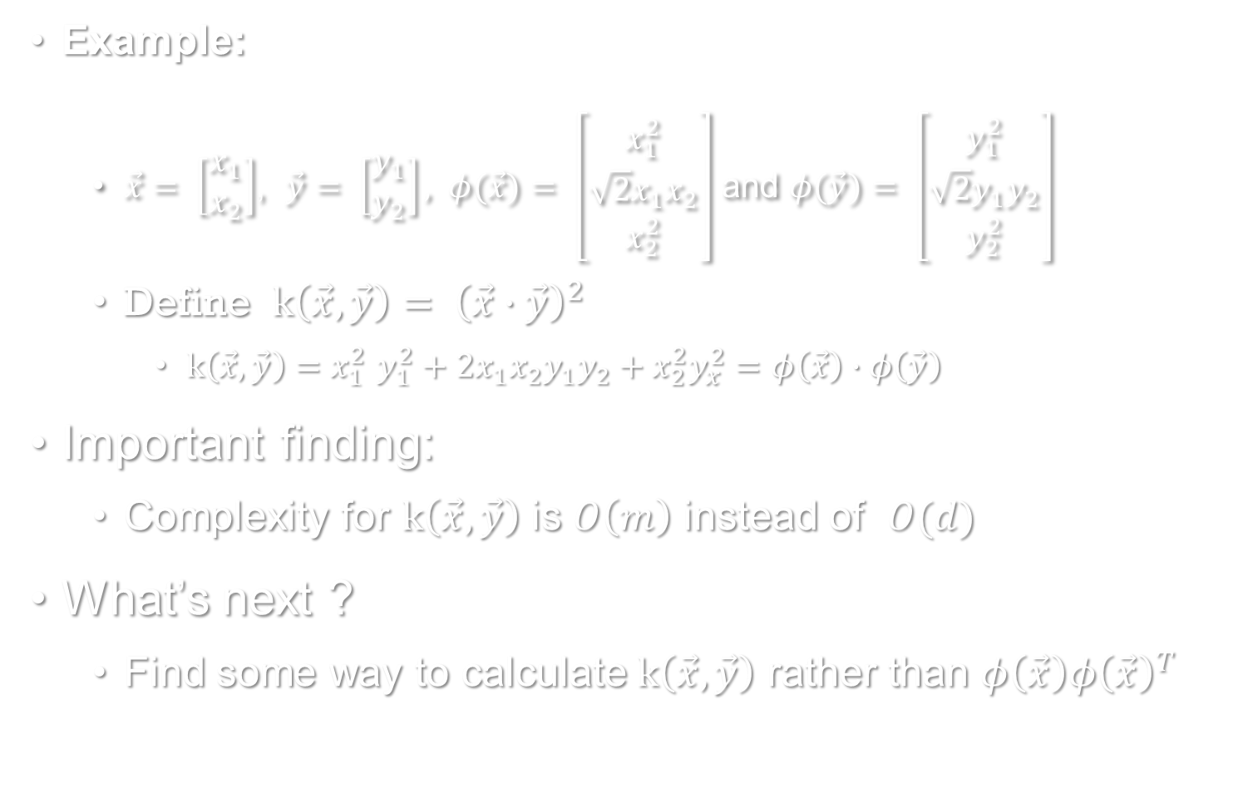
“Kernel Trick”(1)
Example:
$\vec{x}= \left[\begin{matrix}x_{1} \\ x_{2}\end{matrix}\right]$, $\vec{y}= \left[\begin{matrix}y_{1} \\ y_{2}\end{matrix}\right], φ(\vec{x})= \left[\begin{matrix}x_{1}^{2} \\ \sqrt{2}x_{1}x_{2} \\ x_{2}^{2}\end{matrix}\right]$ and $φ(\vec{y})= \left[\begin{matrix}y_{1}^{2} \\ \sqrt{2}y_{1}y_{2} \\ y_{2}^{2}\end{matrix}\right]$
Define $k\left(\vec{x}, \vec{y}\right){= \left(\vec{x}∙\vec{y}\right)}^{2}$
$k\left(\vec{x}, \vec{y}\right){=x}_{1}^{2}y_{1}^{2}+2x_{1}x_{2}y_{1}y_{2}+x_{2}^{2}y_{x}^{2}=φ\left(\vec{x}\right)∙φ\left(\vec{y}\right)$
Important finding:
Complexity for $k\left(\vec{x}, \vec{y}\right)$ is $O\left(m\right)$ instead of $O(d)$
What’s next ?
Find some way to calculate $k\left(\vec{x}, \vec{y}\right)$ rather than $φ\left(\vec{x}\right){φ\left(\vec{x}\right)}^{T}$

Slide 17
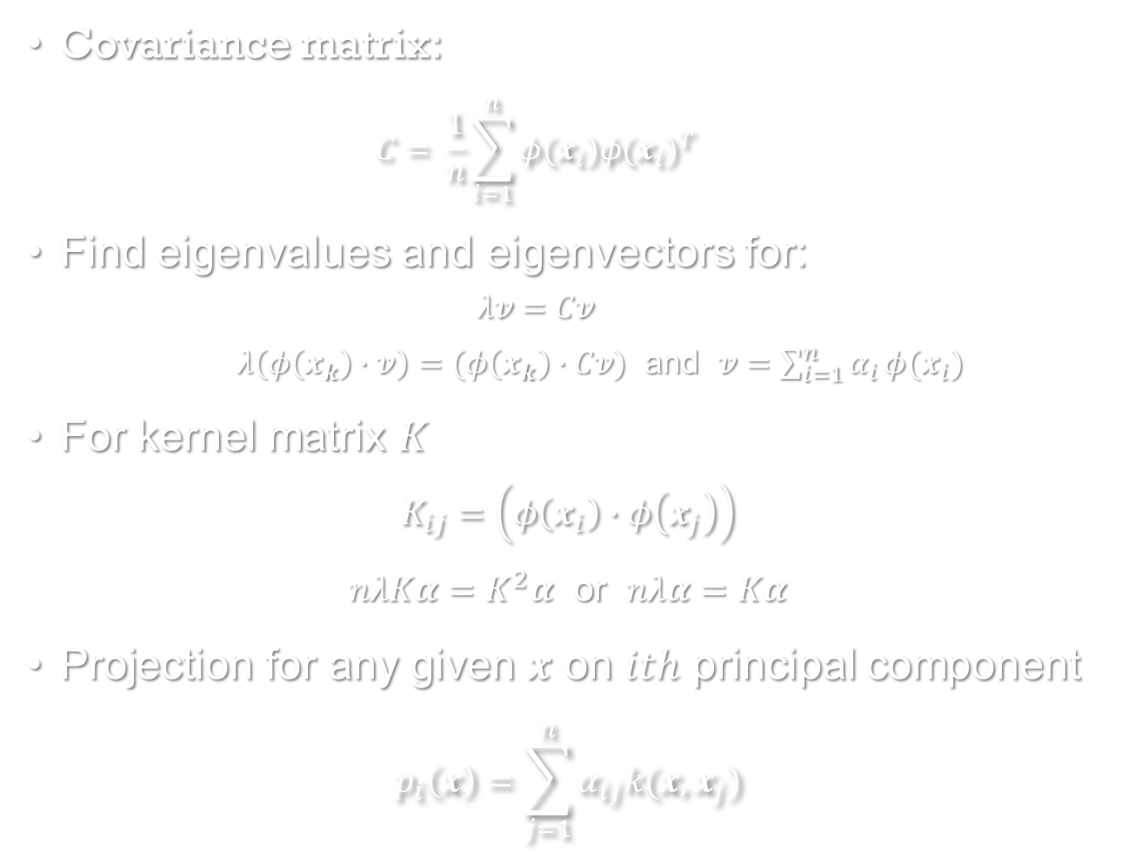
“Kernel Trick”(2)
Covariance matrix:
$$C= \frac{1}{n}\sum_{i=1}^{n}{φ(x_{i}){φ(x_{i})}^{T}}$$
Find eigenvalues and eigenvectors for:
$$λv=Cv$$
$λ\left(φ\left(x_{k}\right)∙v\right)=(φ\left(x_{k}\right)∙Cv)$ and $v=\sum_{i=1}^{n}{α_{i}}φ(x_{i})$
For kernel matrix $K$
$$K_{ij}=\left(φ\left(x_{i}\right)∙φ\left(x_{j}\right)\right)$$
$nλKα=K^{2}α$ or $nλα=Kα$
Projection for any given $x$ on $ith$ principal component
$$p_{i}\left(x\right)=\sum_{j=1}^{n}{α_{ij}k(x, x_{j})}$$

Slide 18

Kernel PCA Algorithm
Instead of finding covariance matrix, we need to calculate the kernel matrix $K$
Instead of finding the eigenvalues and eigenvectors for covariance matrix, we find them for kernel matrix $K$
* Bishop, C. M. Pattern Recognition and Machine Learning.

Slide 19
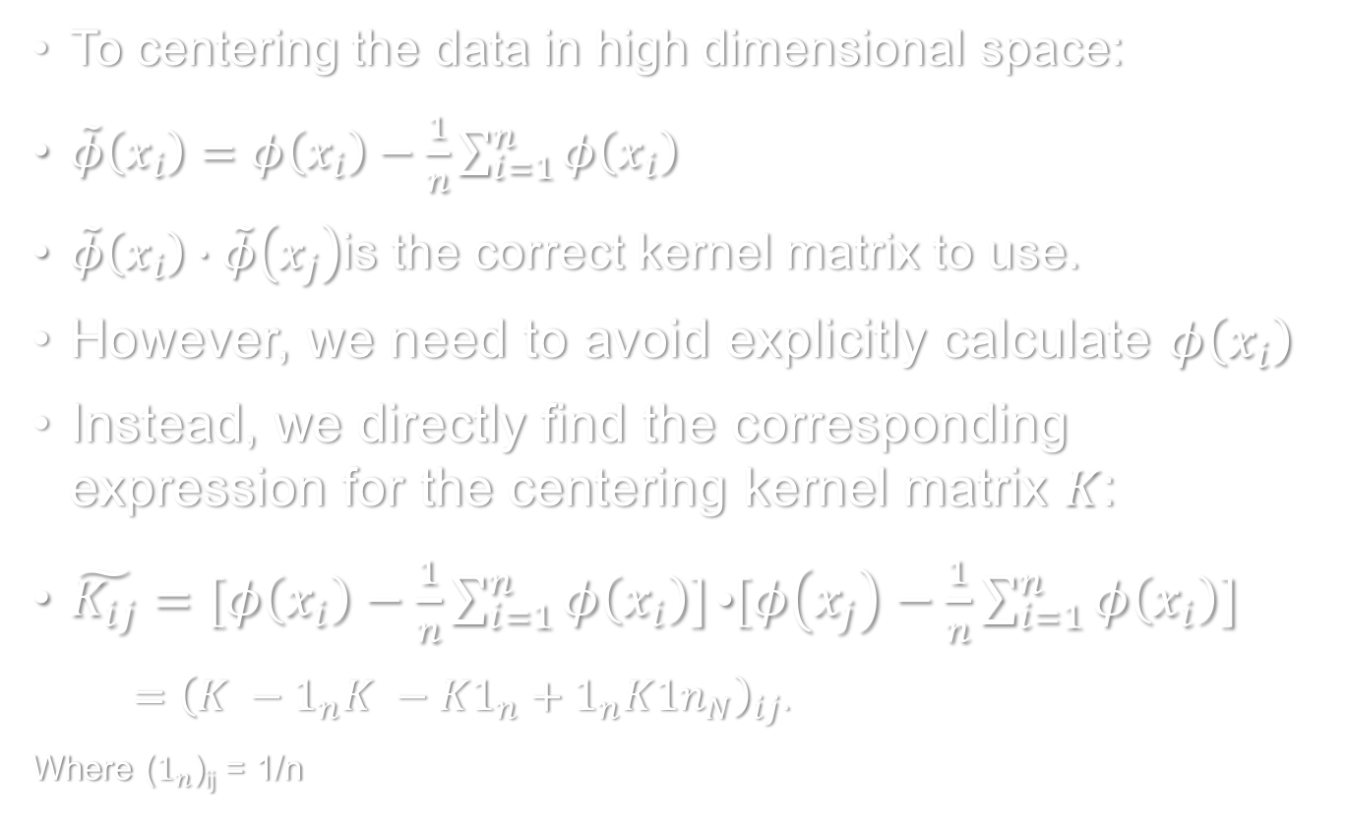
Kernel PCA Algorithm
To centering the data in high dimensional space:
$\tilde{φ}\left(x_{i}\right)=φ\left(x_{i}\right)−\frac{1}{n}\sum_{i=1}^{n}{φ\left(x_{i}\right)}$
$\tilde{φ}\left(x_{i}\right)∙\tilde{φ}\left(x_{j}\right)$is the correct kernel matrix to use.
However, we need to avoid explicitly calculate $φ\left(x_{i}\right)$
Instead, we directly find the corresponding expression for the centering kernel matrix $K$:
$\tilde{K_{ij}}=[φ\left(x_{i}\right)−\frac{1}{n}\sum_{i=1}^{n}{φ\left(x_{i}\right)]}\text{•}[φ\left(x_{j}\right)−\frac{1}{n}\sum_{i=1}^{n}{φ\left(x_{i}\right)]}$
${ =\left(K −1_{n}K −K1_{n}+1_{n}K{1n}_{N}\right)}_{ij}$.
Where ($1_{n}$)_{ij} = 1/n

Slide 20
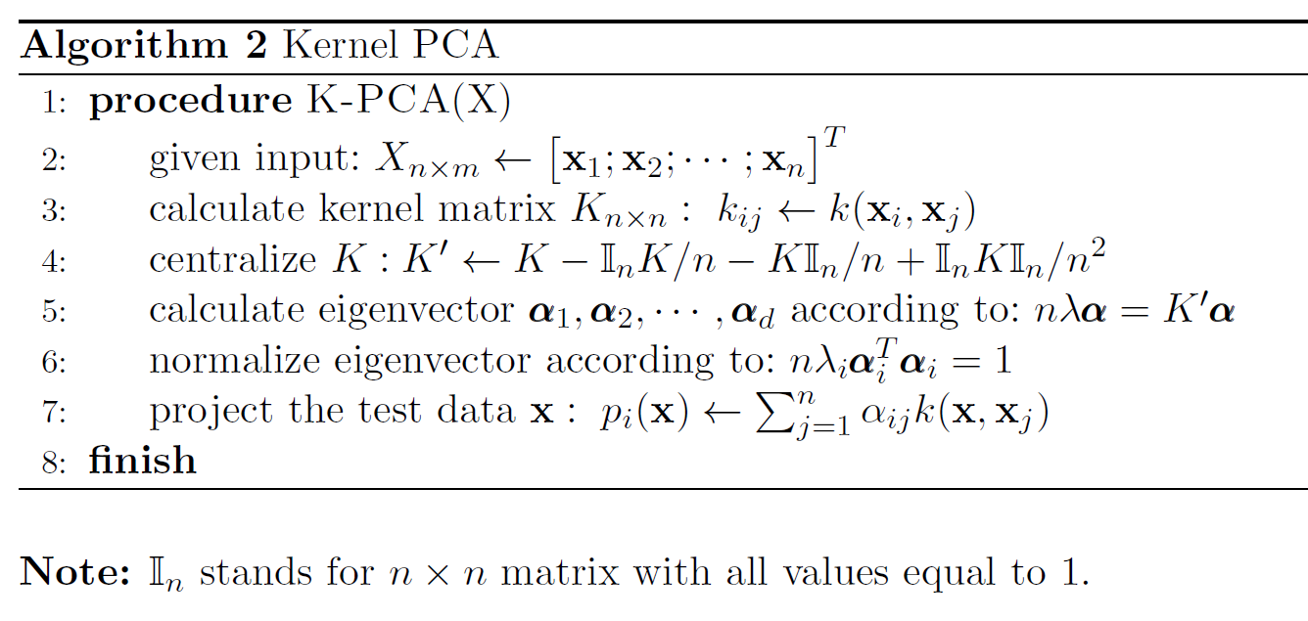

Kernel PCA Algorithm
$$v=\sum_{i=1}^{n}{α_{i}}φ(x_{i})$$
Remember that eigenvector is the linear combination of feature vectors:
* Bishop, C. M. Pattern Recognition and Machine Learning.

Slide 21
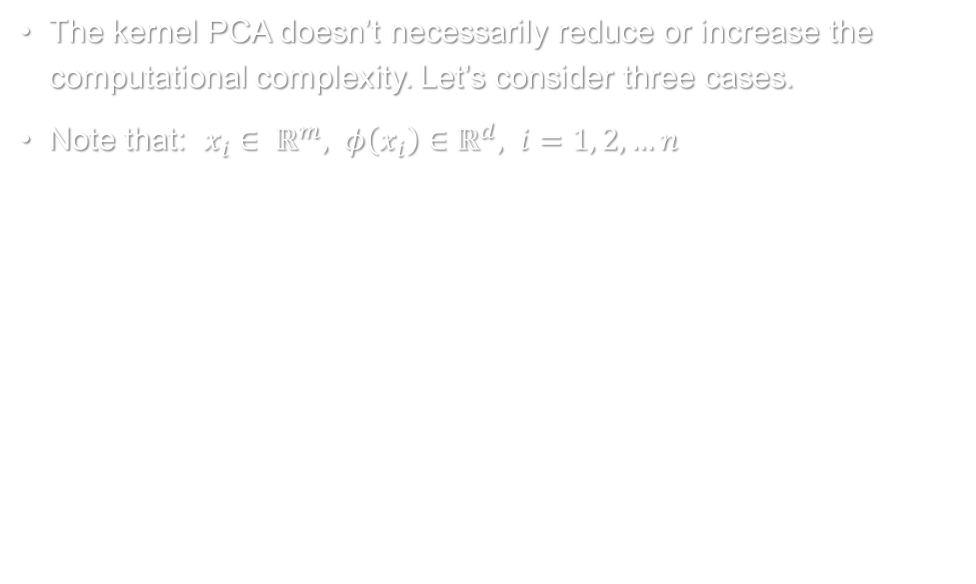
Computational Complexity
The kernel PCA doesn’t necessarily reduce or increase the computational complexity. Let’s consider three cases.
Note that: $x_{i}∈ ℝ^{m}, φ\left(x_{i}\right)∈ℝ^{d}, i=1, 2, …n$
* Bishop, C. M. Pattern Recognition and Machine Learning.

Slide 22
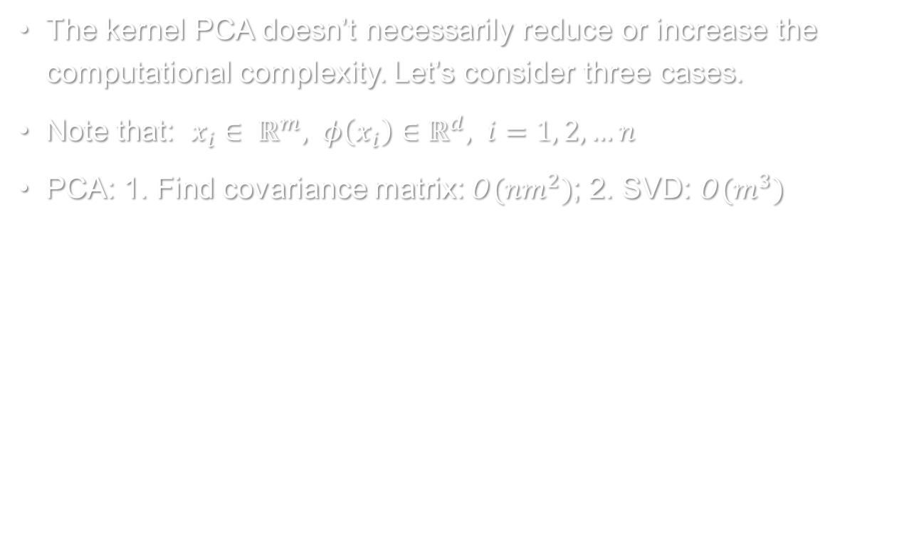
Computational Complexity
The kernel PCA doesn’t necessarily reduce or increase the computational complexity. Let’s consider three cases.
Note that: $x_{i}∈ ℝ^{m}, φ\left(x_{i}\right)∈ℝ^{d}, i=1, 2, …n$
PCA: 1. Find covariance matrix: $O(nm^{2})$; 2. SVD: $O(m^{3})$
* Bishop, C. M. Pattern Recognition and Machine Learning.

Slide 23
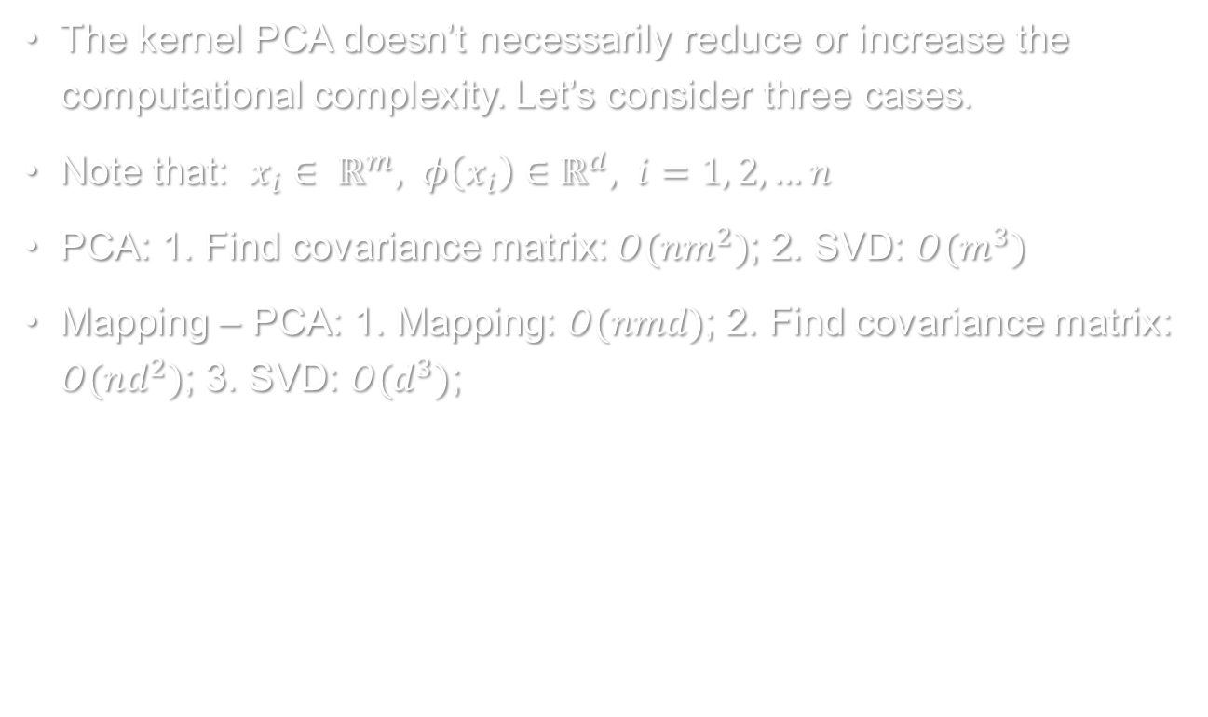
Computational Complexity
The kernel PCA doesn’t necessarily reduce or increase the computational complexity. Let’s consider three cases.
Note that: $x_{i}∈ ℝ^{m}, φ\left(x_{i}\right)∈ℝ^{d}, i=1, 2, …n$
PCA: 1. Find covariance matrix: $O(nm^{2})$; 2. SVD: $O(m^{3})$
Mapping – PCA: 1. Mapping: $O(nmd)$; 2. Find covariance matrix: $O(nd^{2})$; 3. SVD: $O(d^{3})$;
* Bishop, C. M. Pattern Recognition and Machine Learning.

Slide 24
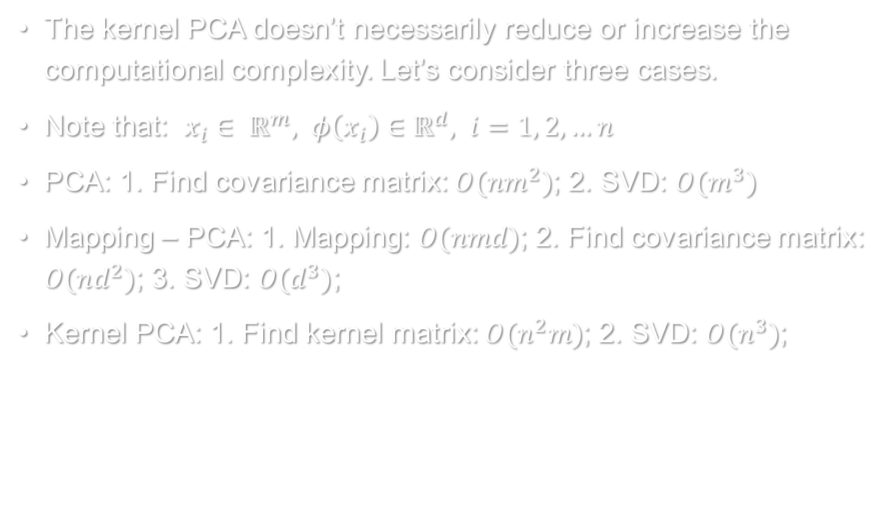
Computational Complexity
The kernel PCA doesn’t necessarily reduce or increase the computational complexity. Let’s consider three cases.
Note that: $x_{i}∈ ℝ^{m}, φ\left(x_{i}\right)∈ℝ^{d}, i=1, 2, …n$
PCA: 1. Find covariance matrix: $O(nm^{2})$; 2. SVD: $O(m^{3})$
Mapping – PCA: 1. Mapping: $O(nmd)$; 2. Find covariance matrix: $O(nd^{2})$; 3. SVD: $O(d^{3})$;
Kernel PCA: 1. Find kernel matrix: $O(n^{2}m)$; 2. SVD: $O(n^{3})$;
* Bishop, C. M. Pattern Recognition and Machine Learning.

Slide 25
Computational Complexity
PCA | Mapping - PCA | Kernel PCA
$$O(nm^{2}+m^{3})$$ | $$O(nmd+nd^{2}+d^{3})$$ | $$O(n^{2}m+n^{3})$$
Linear | Non-linear | Non-linear
For data without linear dependency, PCA is not enough.
Since d > m, mapping – PCA is always more complex than PCA. For very large d it will be impractical to carry out.
Kernel PCA can be more expensive, or not. It depends on the number of instances and the dimension of feature space. However, it can handle non-linear data.

Slide 26
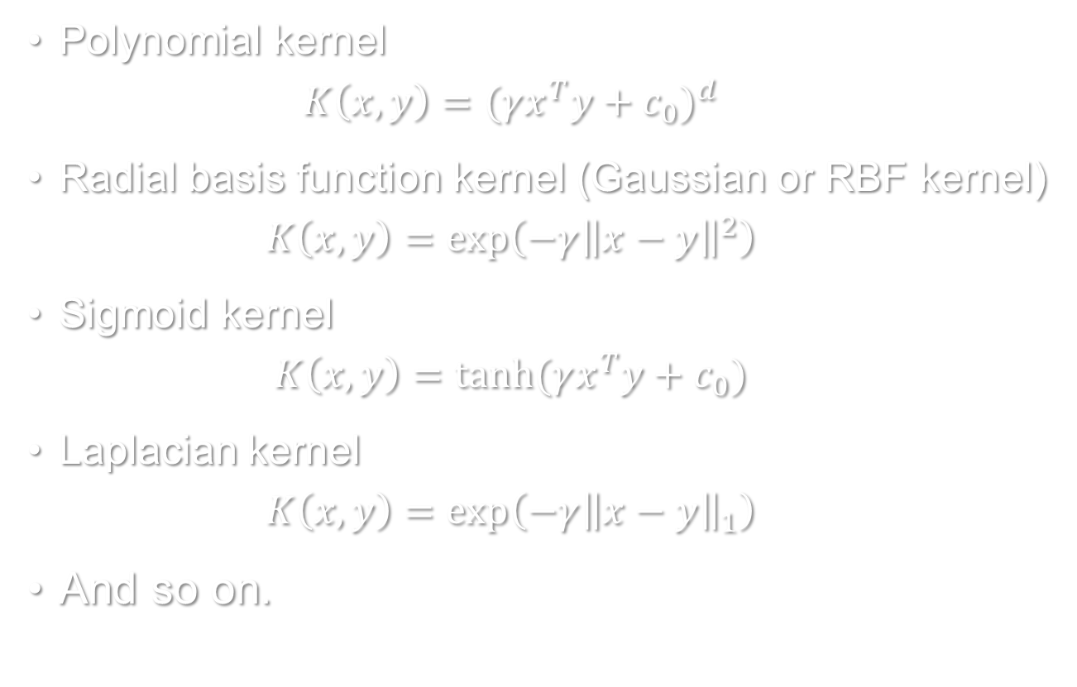
Commonly Used Kernels*
Polynomial kernel
$$K\left(x, y\right)={(γx^{T}y+c_{0})}^{d}$$
Radial basis function kernel (Gaussian or RBF kernel)
$$K\left(x, y\right)=\exp\left(−γ{\left\|x−y\right\|}^{2}\right)$$
Sigmoid kernel
$$K\left(x, y\right)=tanh⁡(γx^{T}y+c_{0})$$
Laplacian kernel
$$K\left(x, y\right)=\exp\left(−γ{\left\|x−y\right\|}_{1}\right)$$
And so on.
* http://scikit-learn.org/stable/modules/metrics.html#metrics

Slide 27
Toy Examples

Slide 28
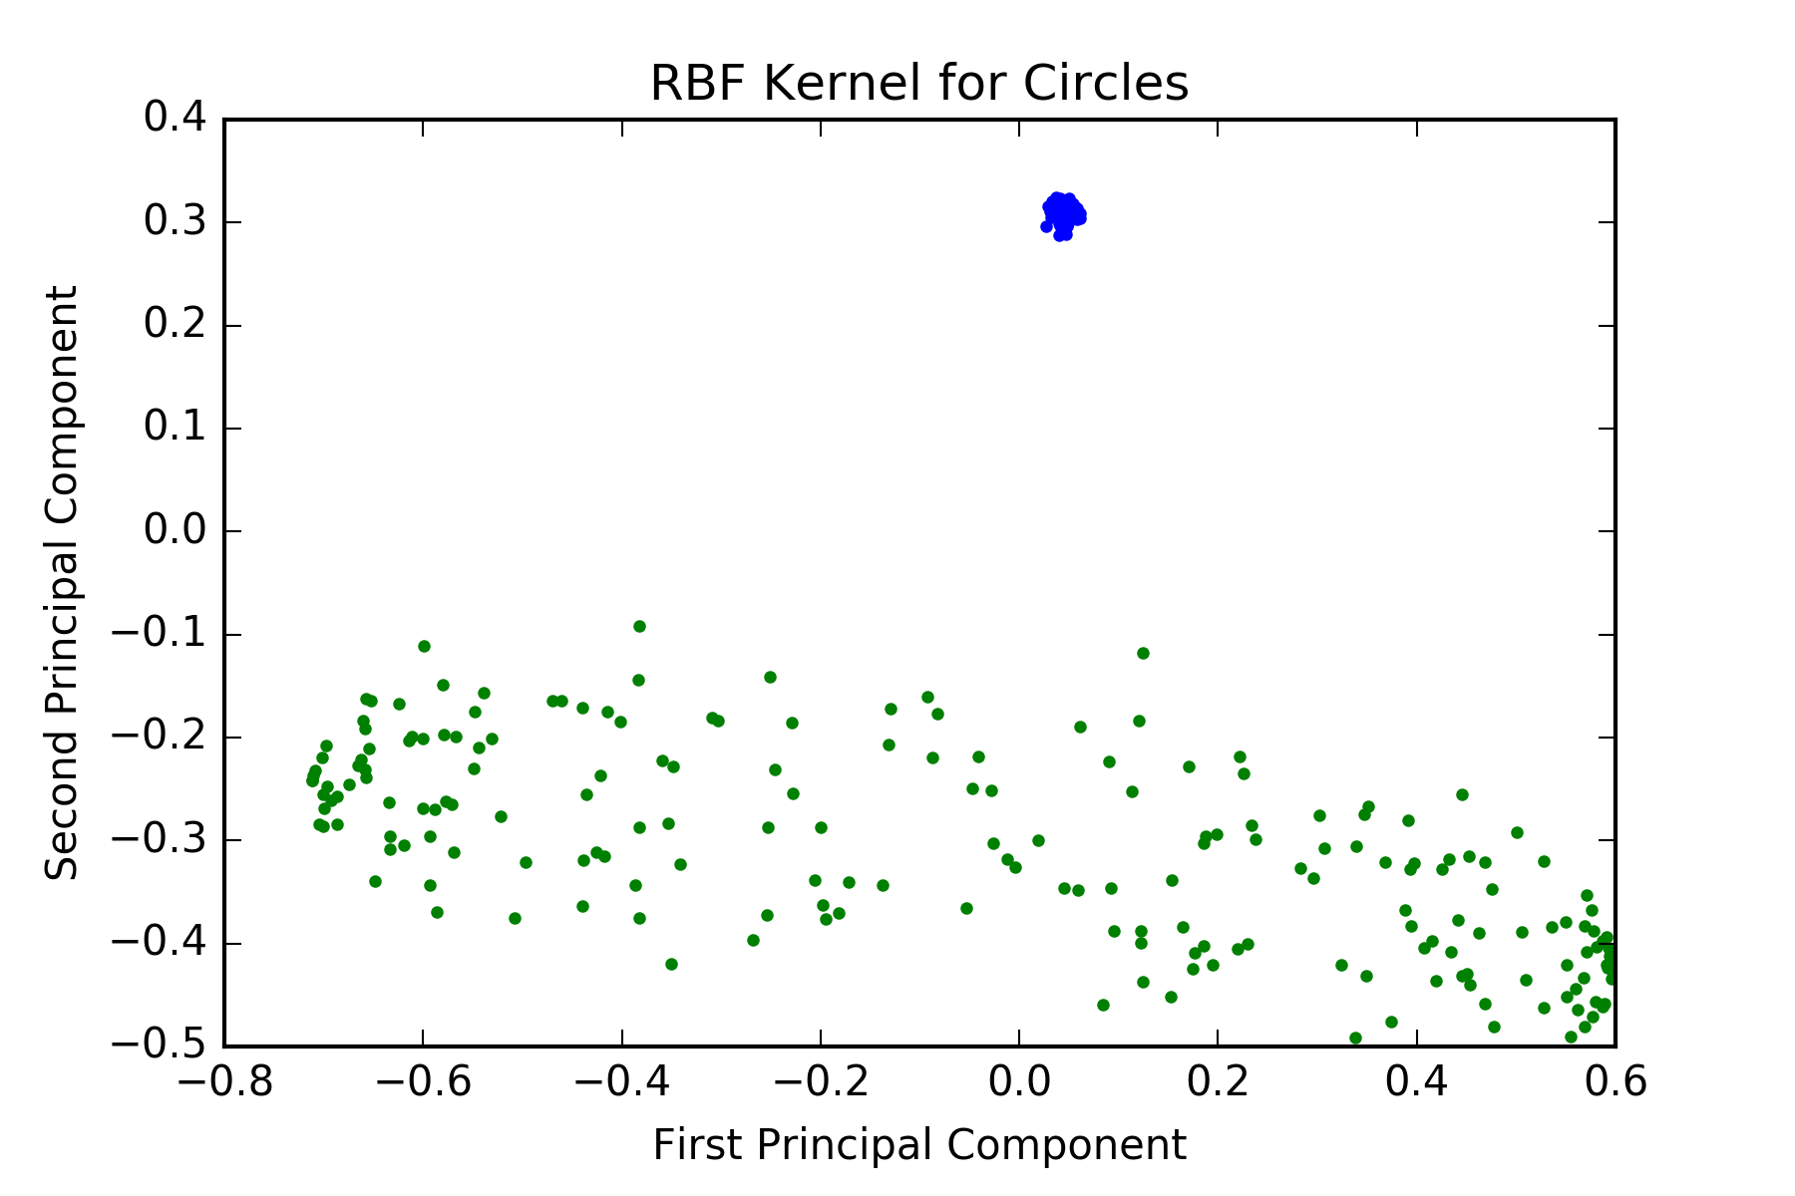
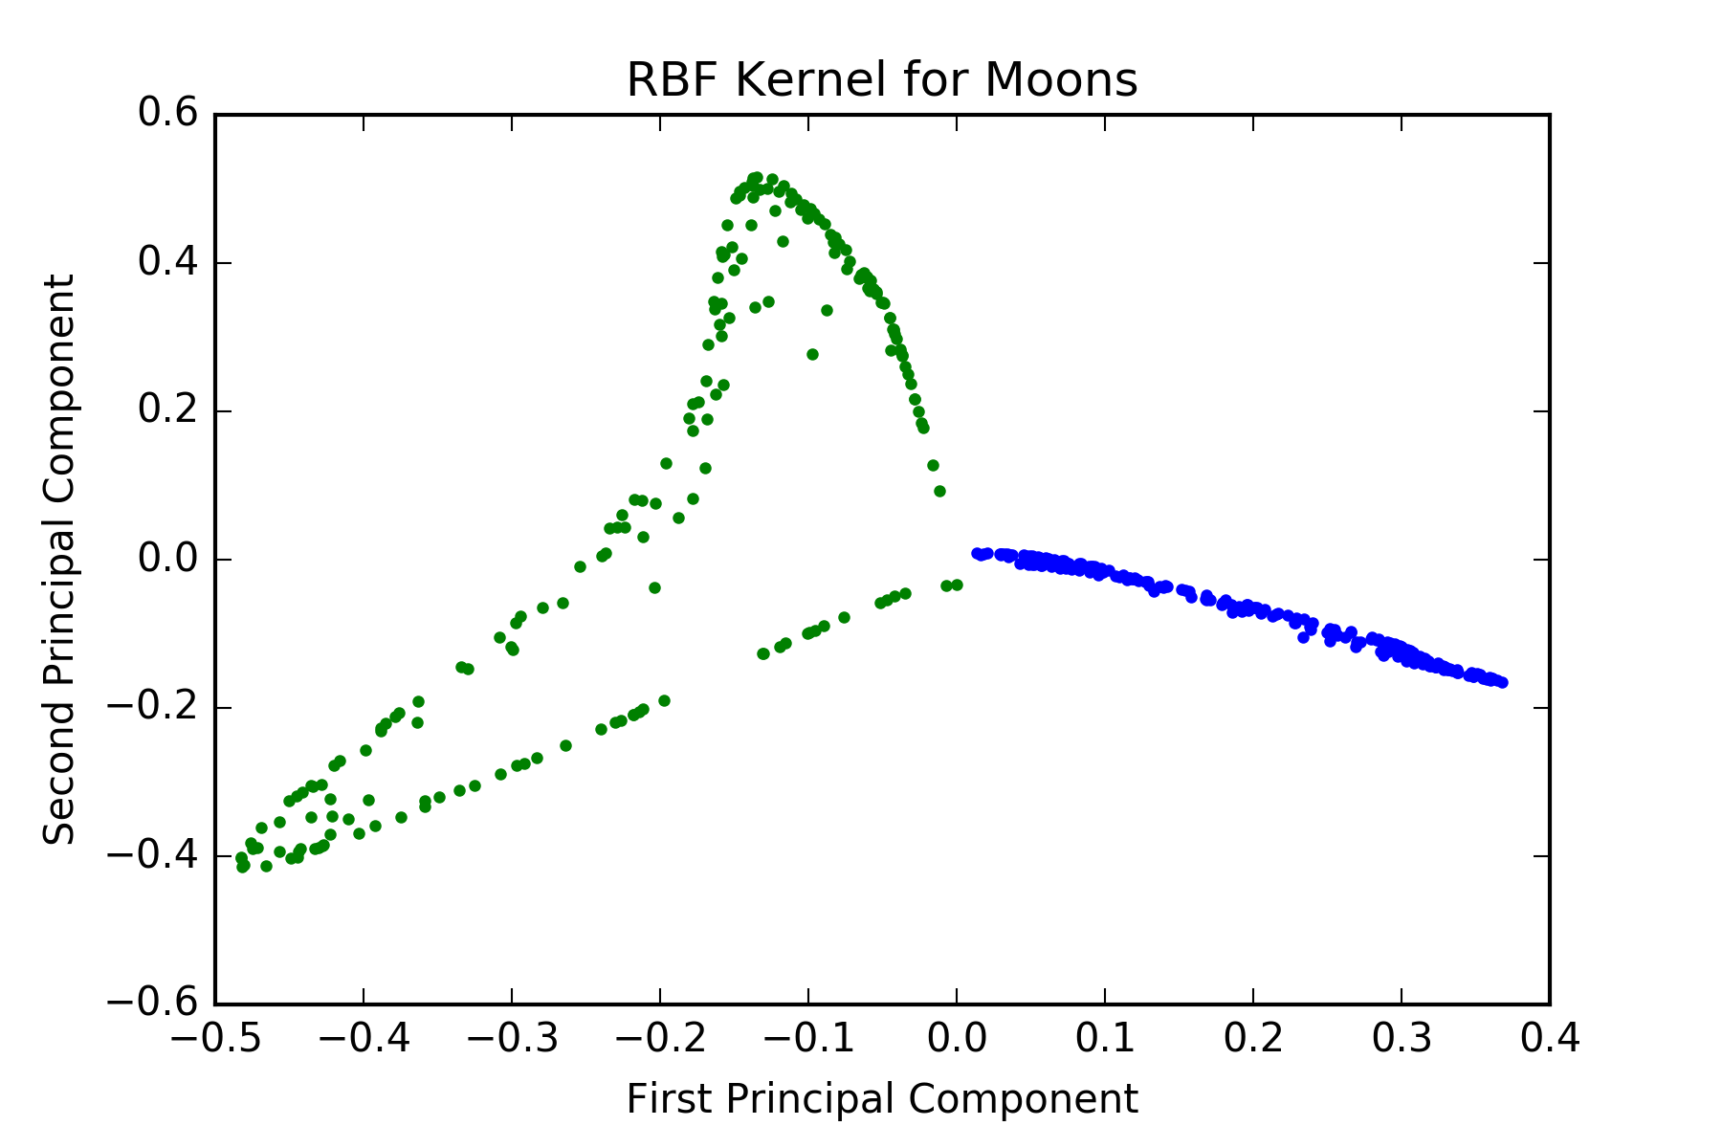
Toy Examples

Slide 29
Iris Dataset – Introduction
Iris flower dataset is introduced by Ronald Fisher (1936)*
It contains 3 different types of irises (Setosa, Versicolor, and Virginica)**.
The dataset has 150 records and each has 4 features:
Sepal Length
Sepal Width
Petal Length
Petal Width.
* https://en.wikipedia.org/wiki/Iris_flower_data_set
** http://scikit-learn.org/stable/auto_examples/datasets/plot_iris_dataset.html

Slide 30
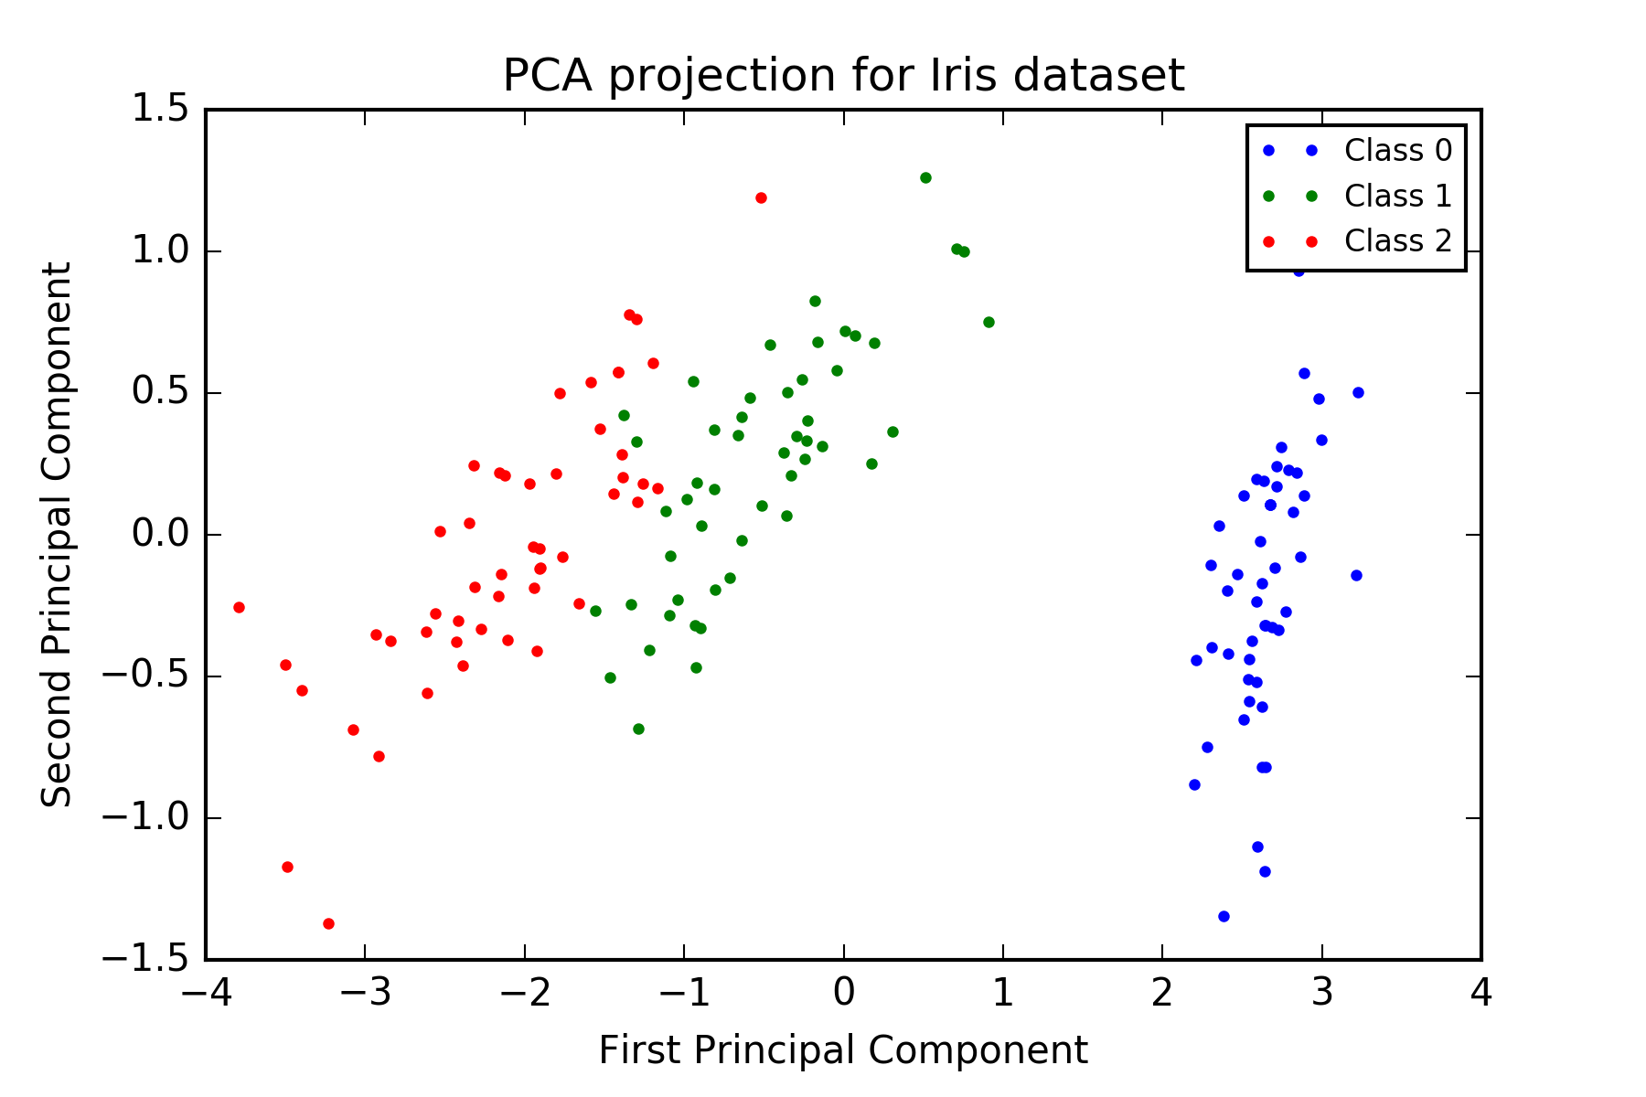
Iris Dataset – PCA vs. K-PCA

Slide 31
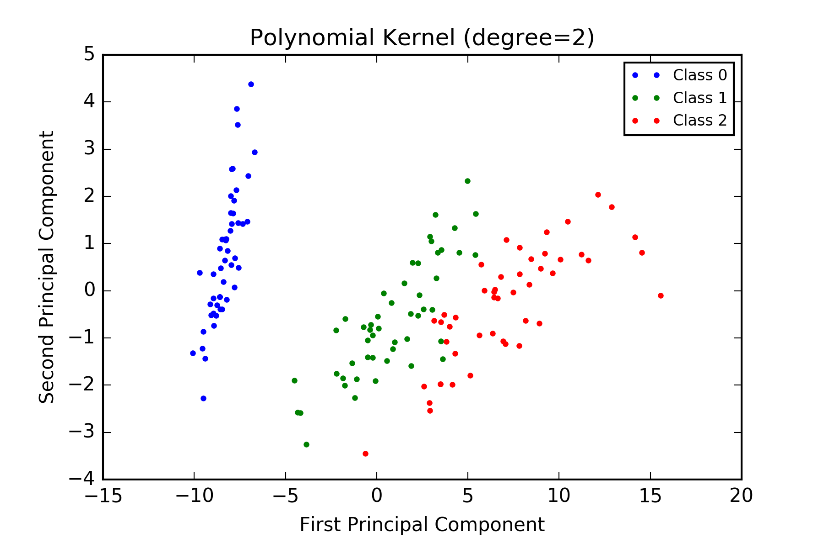
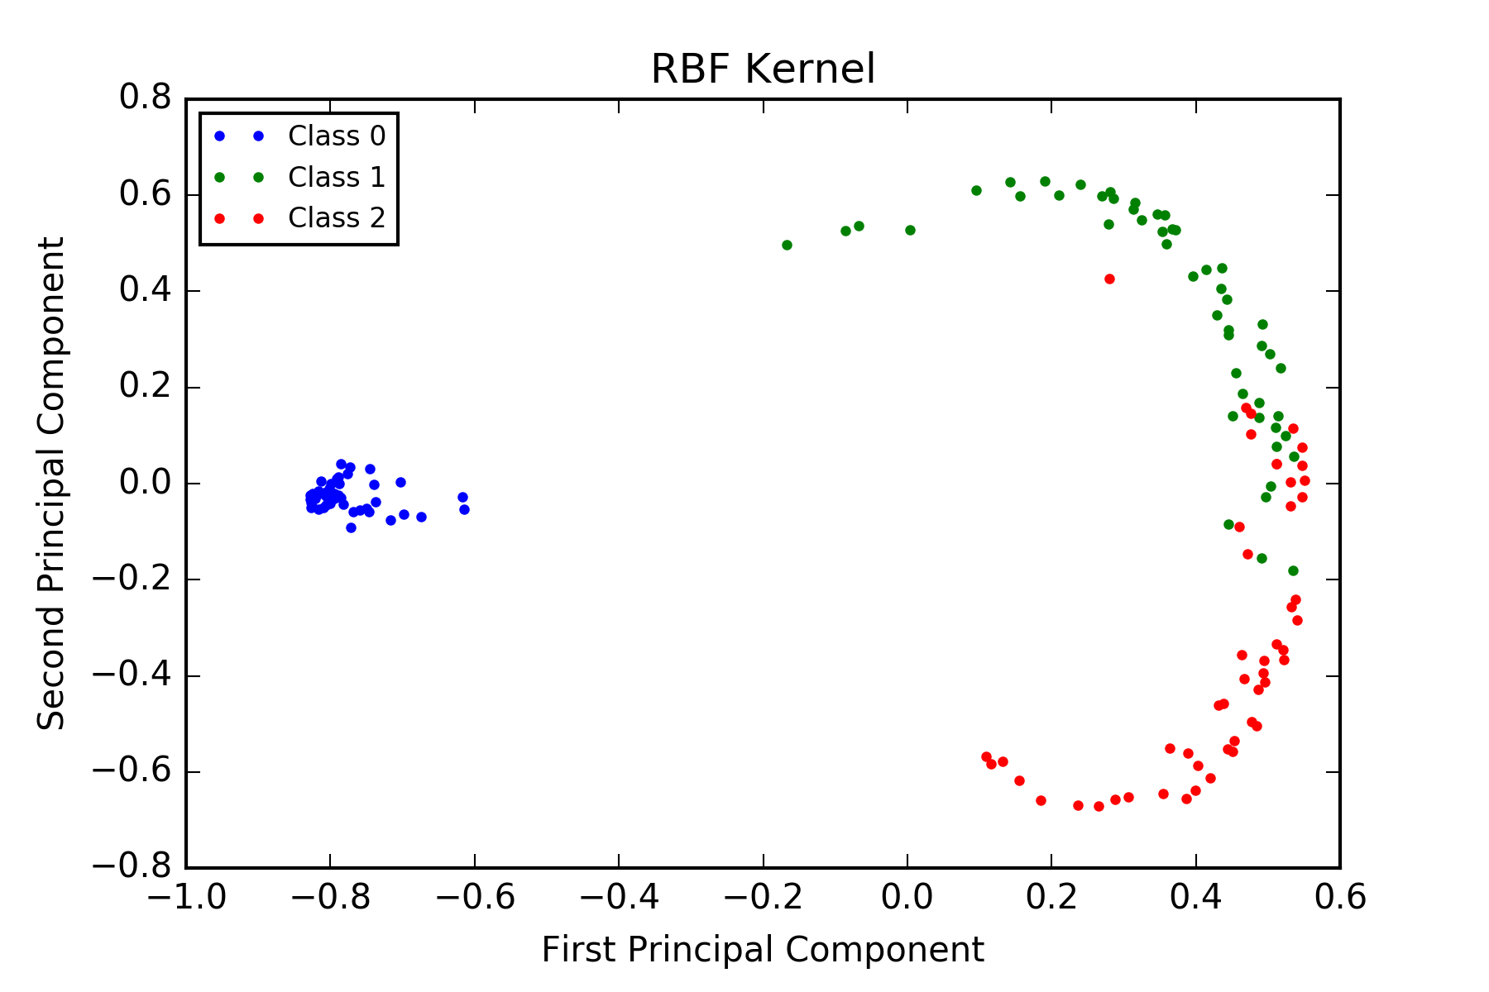
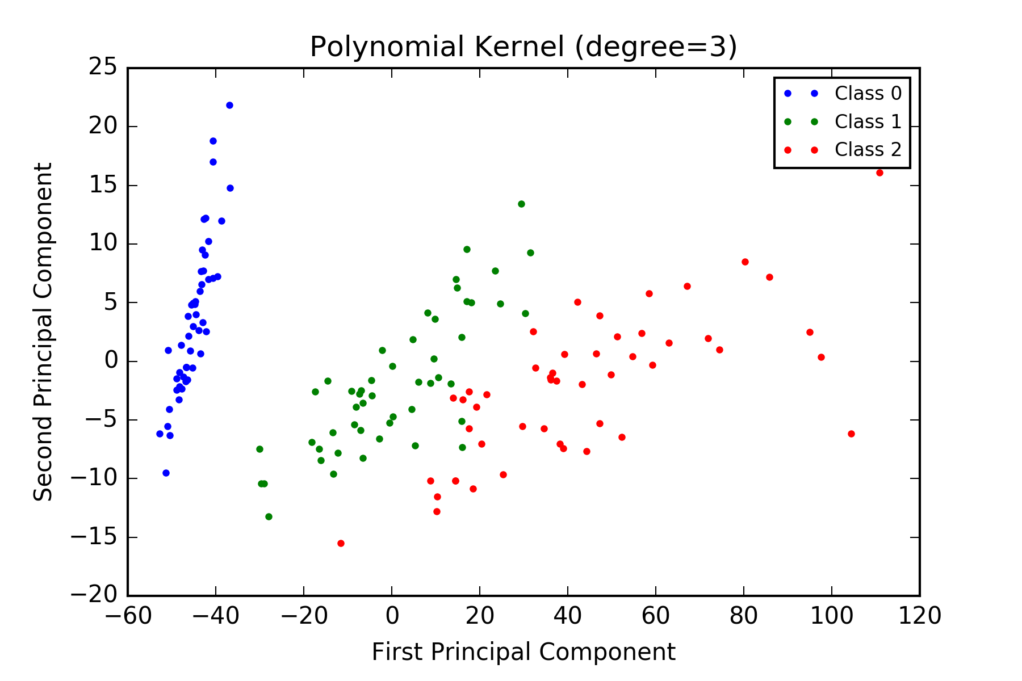
Iris Dataset – PCA vs. K-PCA

Slide 32
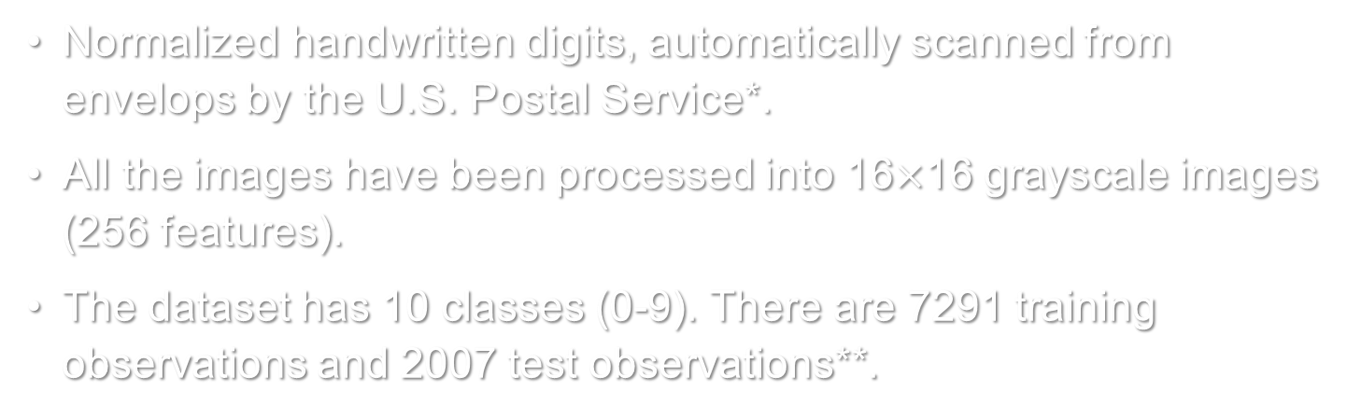
Digits Dataset – Introduction
Normalized handwritten digits, automatically scanned from envelops by the U.S. Postal Service*.
All the images have been processed into 16$×$16 grayscale images (256 features).
The dataset has 10 classes (0-9). There are 7291 training observations and 2007 test observations**.
Class | 0 | 1 | 2 | 3 | 4 | 5 | 6 | 7 | 8 | 9 | Total
Train | 1194 | 1005 | 731 | 658 | 652 | 556 | 664 | 645 | 542 | 644 | 7291
Test | 359 | 264 | 198 | 166 | 200 | 160 | 170 | 147 | 166 | 177 | 2007
* http://statweb.stanford.edu/~tibs/ElemStatLearn/datasets/zip.info.txt
** https://www.otexts.org/1577

Slide 33
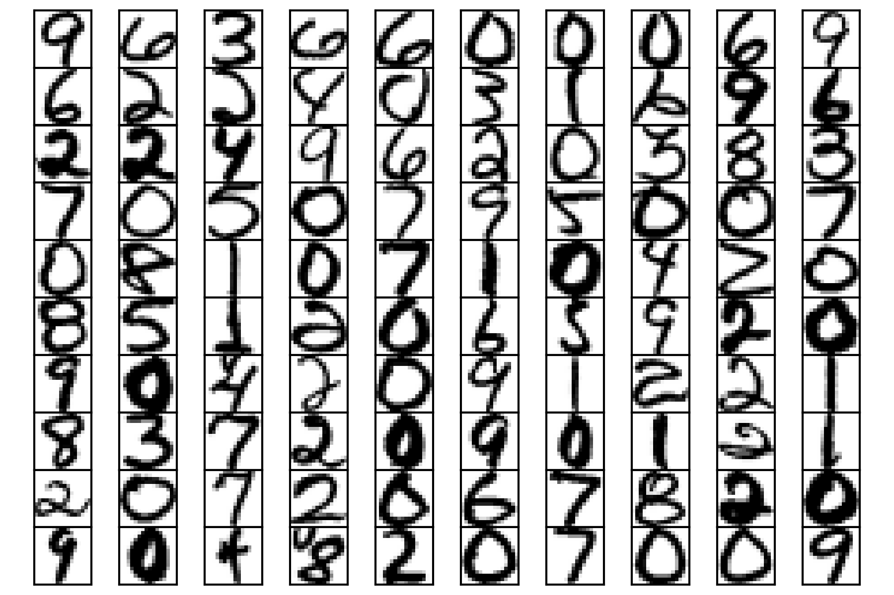
Digits Dataset – Introduction

Slide 34
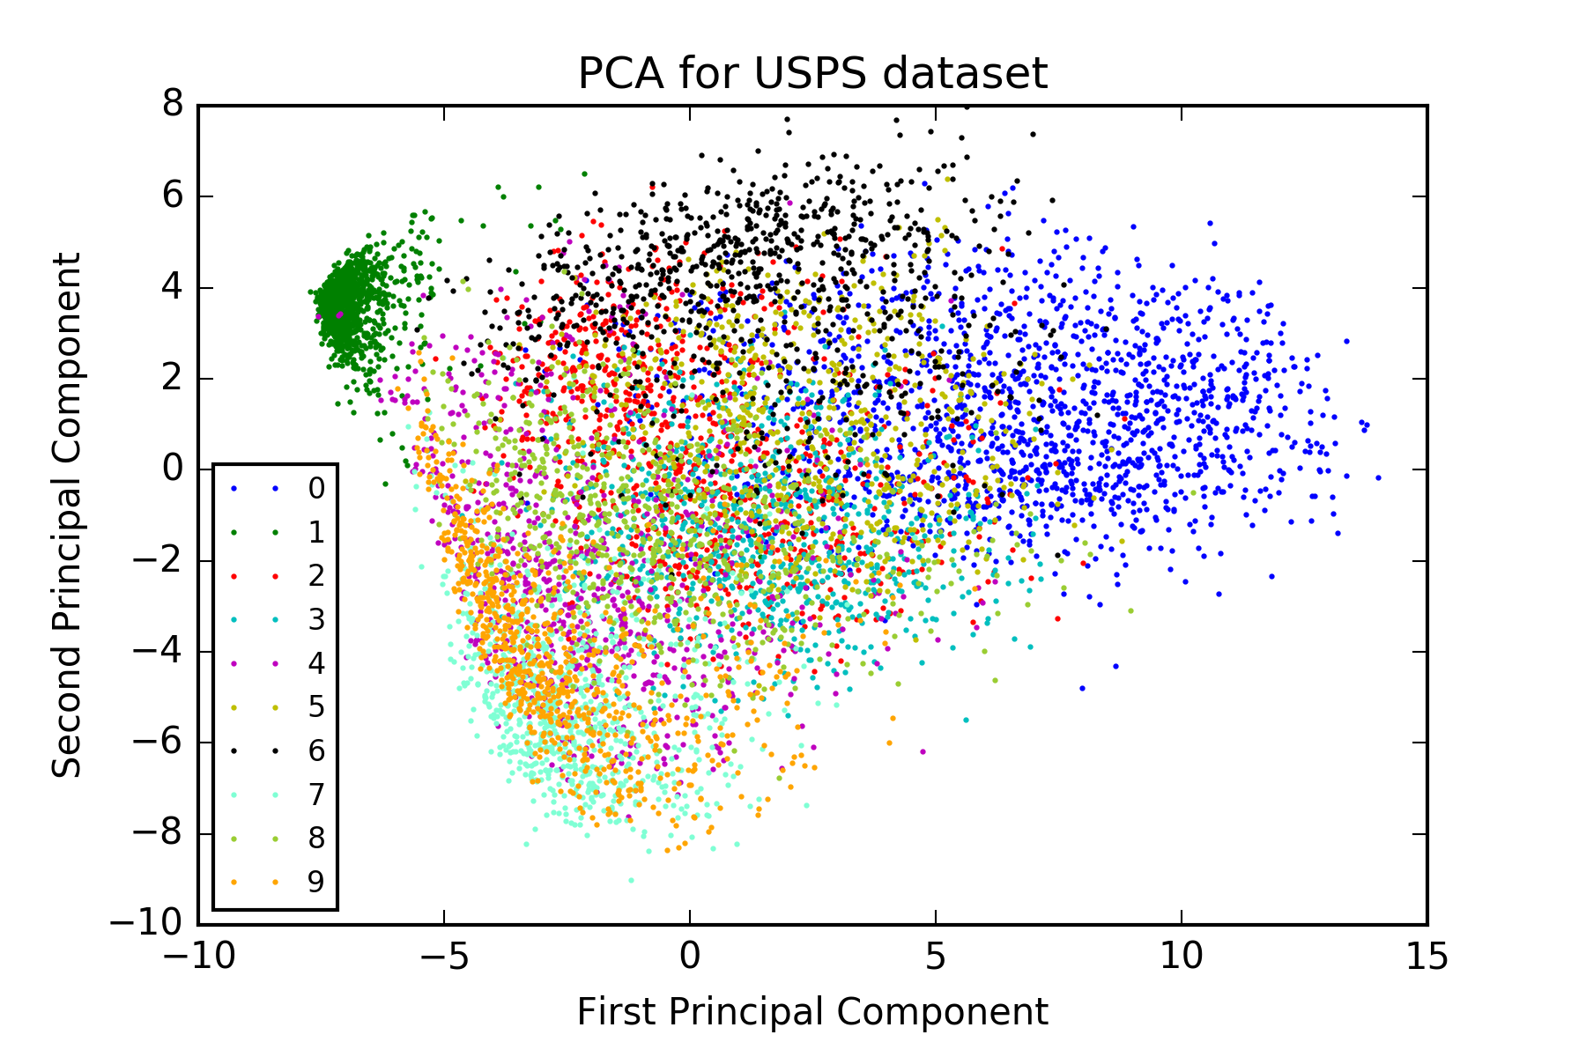
Digits Dataset – PCA vs. K-PCA

Slide 35
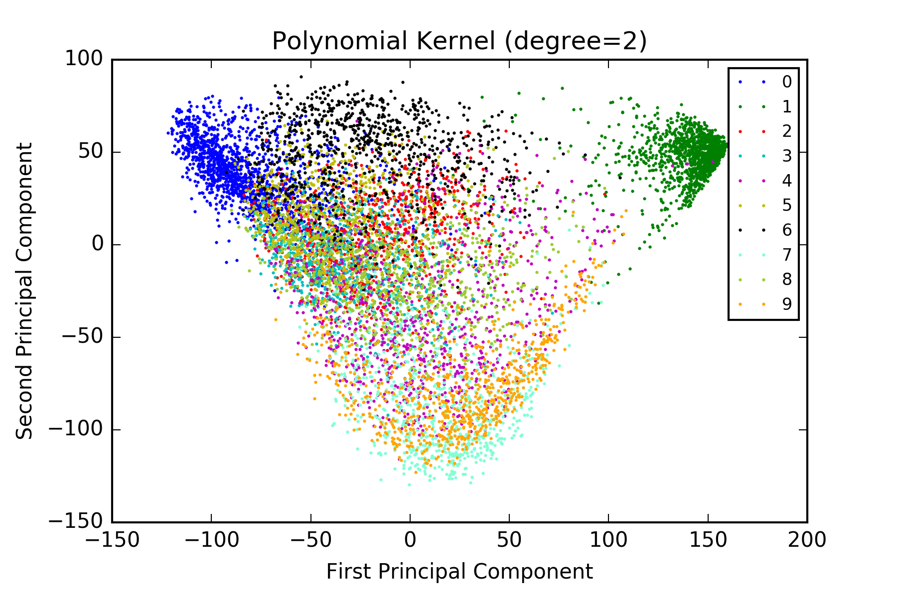
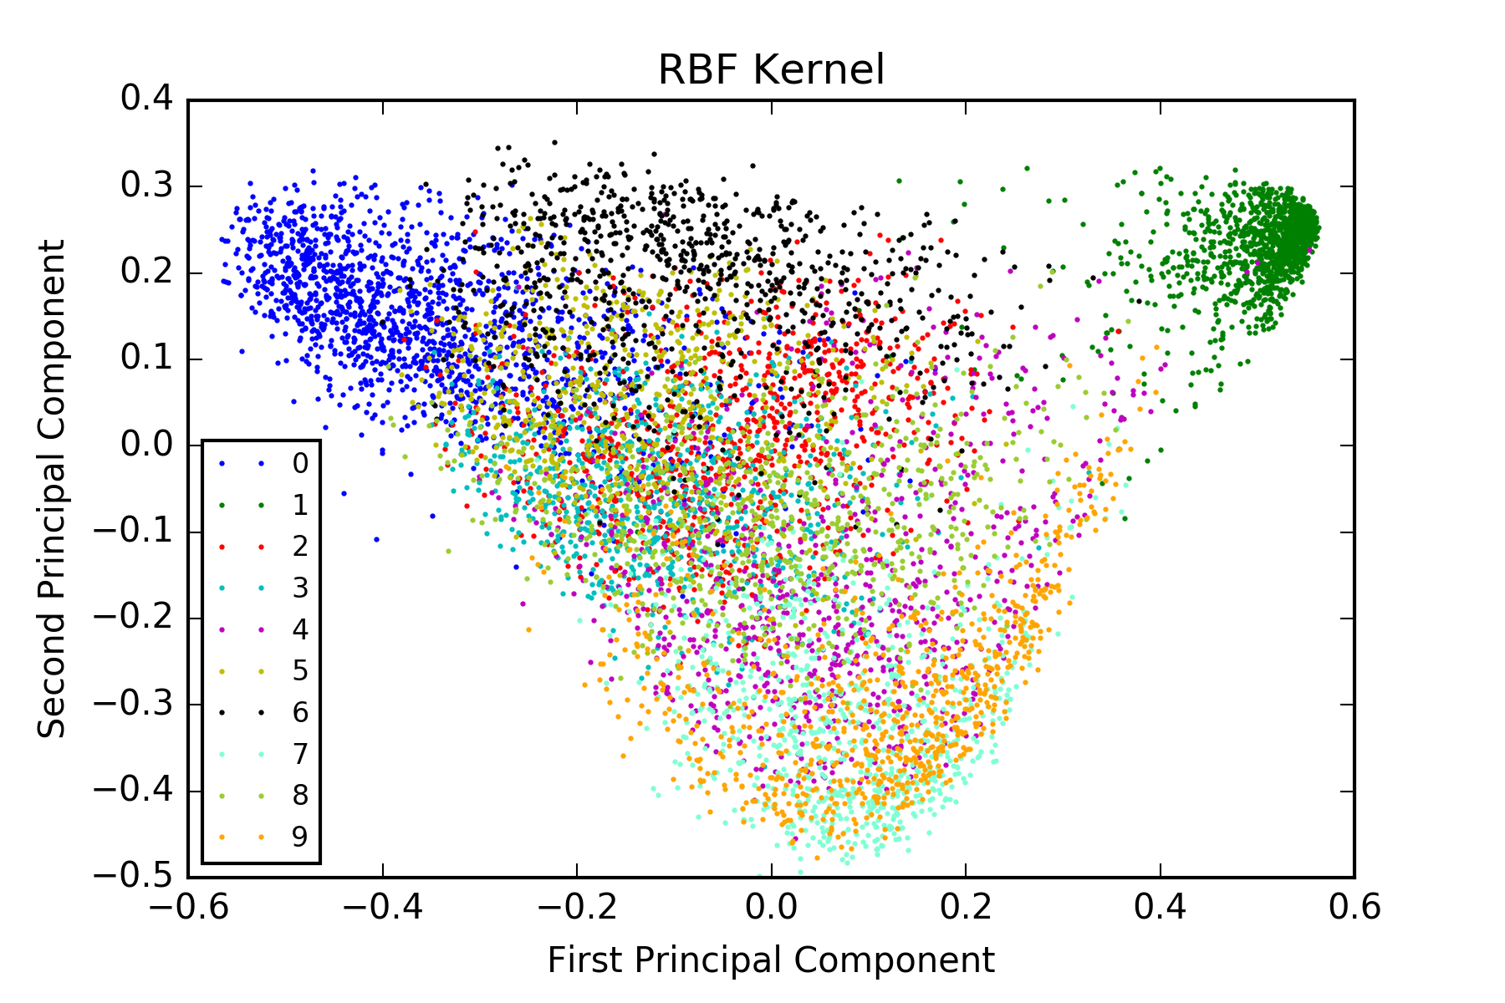
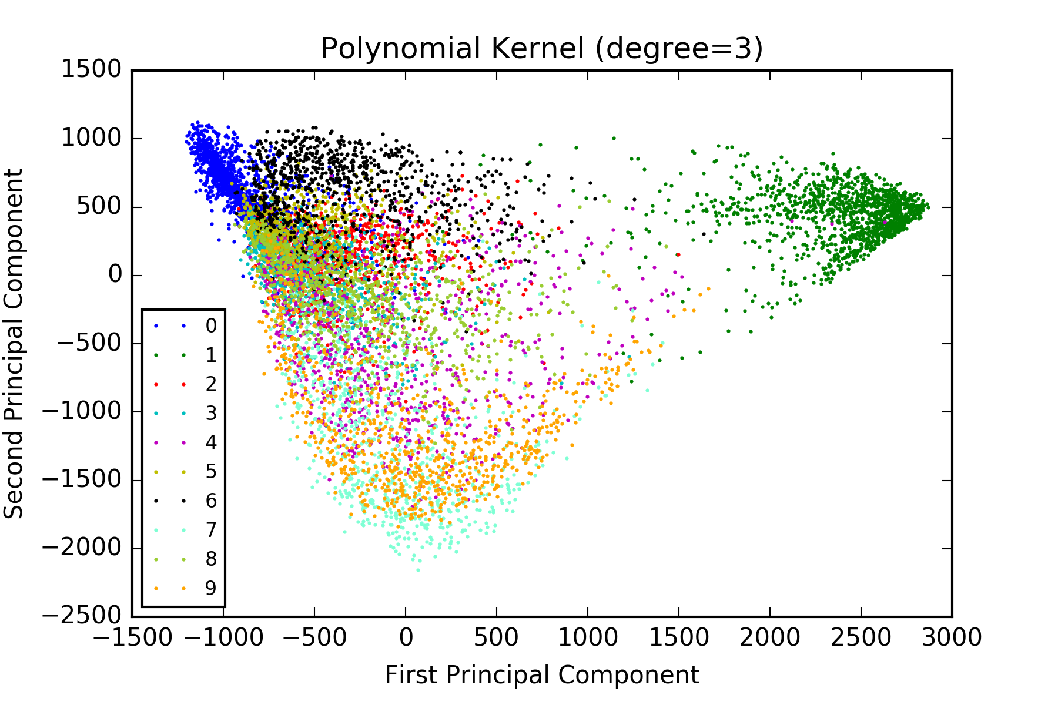
Digits Dataset – PCA vs. K-PCA

Slide 36
Digits Dataset – Classification
Train a 10-way multi-class neural network for classification
0
1
………
9
X1
X2
…………
Xp
+1

Slide 37
Digits Dataset – Classification
Train a 10-way multi-class neural network for classification
Training accuracy and testing accuracy
0
1
………
9
X1
X2
…………
Xp
+1
Inputs | Raw image | PCA | Polynomial Kernel (degree=2) | Polynomial Kernel (degree=3) | RBF Kernel
Feature Number | 256 | 128 | 512 | 1024 | 1024
Training Accuracy | 95.52% | 94.94% | 99.99% | 98.51% | 93.58%
Test Accuracy | 90.98% | 90.23% | 94.42% | 93.92% | 88.14%

Slide 38
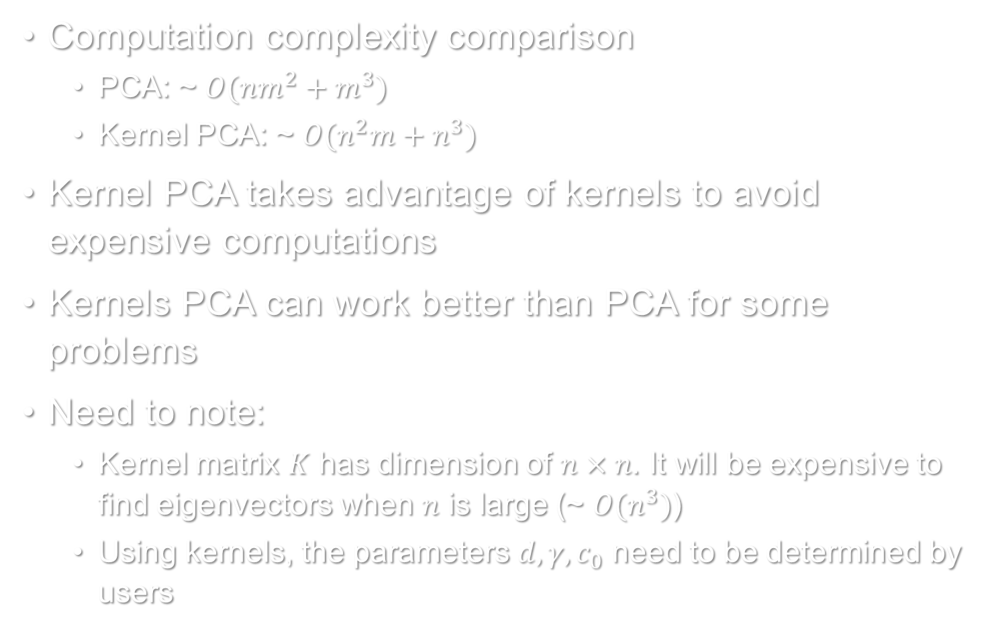
Summary
Computation complexity comparison
PCA: ~ $O(nm^{2}+m^{3})$
Kernel PCA: ~ $O(n^{2}m+n^{3})$
Kernel PCA takes advantage of kernels to avoid expensive computations
Kernels PCA can work better than PCA for some problems
Need to note:
Kernel matrix $K$ has dimension of $n×n$. It will be expensive to find eigenvectors when $n$ is large (~ $O(n^{3})$)
Using kernels, the parameters $d, γ, c_{0}$ need to be determined by users

Slide 39
Extension
Dimensionality reduction is more generally used
There are methods for dimensionality reduction
Independent Component Analysis (ICA)
Non-negative Matrix Factorization (NMF)
Isometric Feature Mapping (ISOMAP)
Locality Sensitive Hashing (LSH)
Latent Semantic Analysis (LSA)
Restricted Boltzmann Machine (RBM)
Auto-encoders
And so on

Slide 40
Questions?
Language:
Python + TensorFlow
All source codes are available in GitHub
https://github.com/JifuZhao/UIUC_Courses/tree/master/UIUC_IE529/project/code
Thank you.

Slide 41
References
https://en.wikipedia.org/wiki/Principal_component_analysis
http://scikit-learn.org/stable/modules/metrics.html#metrics
https://en.wikipedia.org/wiki/Iris_flower_data_set
http://scikit-learn.org/stable/auto_examples/datasets/plot_iris_dataset.html
https://www.otexts.org/1577
http://statweb.stanford.edu/~tibs/ElemStatLearn/datasets/zip.info.txt
Schölkopf, B., Smola, A. & Müller, K.R., 1998. Nonlinear component analysis as a kernel eigenvalue problem. Neural computation.
Friedman, J., Hastie, T., & Tibshirani, R. The elements of statistical learning.
Bishop, C. M. Pattern Recognition and Machine Learning.

